Slide 1
18CSS202J- COMPUTER COMMUNICATION UNIT 3

Slide 2
Course Objective:
The purpose of learning this course is to
Understand the basic services and concepts related to Internetwork
Understand the layered network architecture
Acquire knowledge in IP addressing
Exploring the services and techniques in physical layer
Understand the functions of Data Link layer
Implement and analyze the different Routing Protocols
Course Outcomes (CO):
At the end of this course, learners will be able to
Apply the knowledge of communication
Identify and design the network topologies
Design the network using addressing schemes
Identify and correct the errors in transmission
Identify the guided and unguided transmission media
Implement the various Routing Protocols

Slide 3
TOPICS TO BE LEARNED:
Session 1: Line Coding Schemes: Unipolar, Polar and Bipolar.
Session 2: Amplitude Shift Keying Technique, Frequency Shift Keying Technique and Phase Shift Keying Technique, Pulse Code Modulation, Delta Modulation
Session 5: Multiplexing: Frequency Division Multiplexing(FDM)
Session 6: Time Division Multiplexing(TDM), Wavelength Division Multiplexing(WDM)
Session 9 : Guided Media: Twisted pair, coaxial and Fiber optic cables, Unguided Media: Radio waves.
Session 10: Microwaves and Infrared.

Slide 4
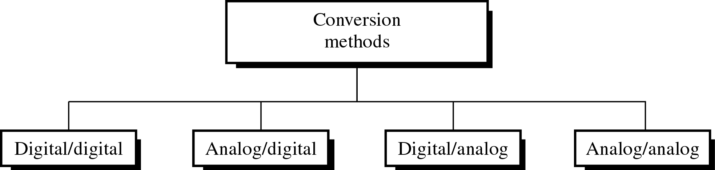
Different Conversion Schemes

Slide 5
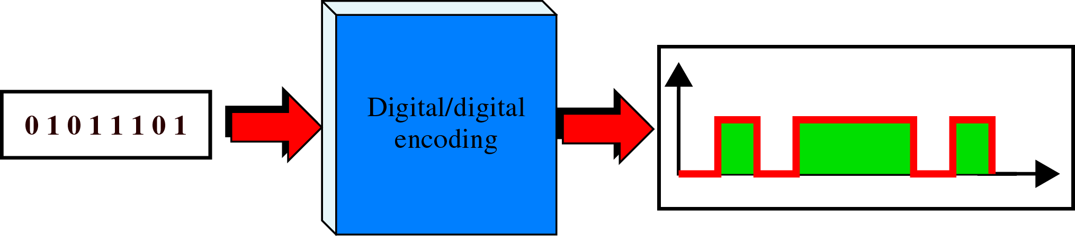
Digital to Digital Encoding

Slide 6
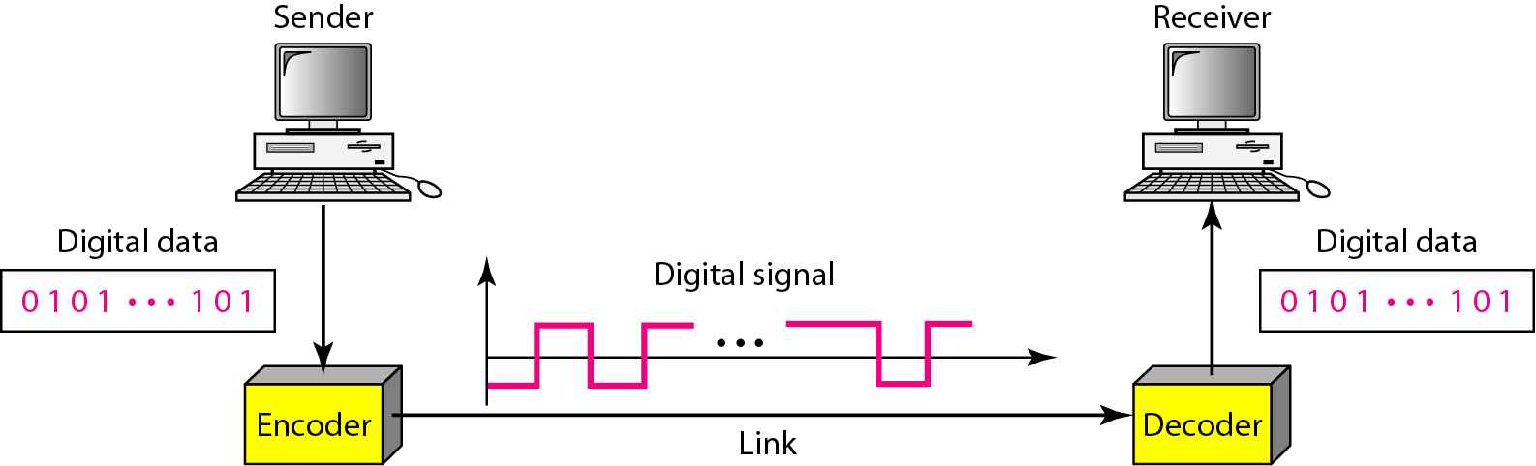
Line coding and decoding

Slide 7
DIGITAL-TO-DIGITAL CONVERSION -LINE CODING
Data can be either digital or analog. Signals that represent data can also be digital or analog. In this section, we see how we can represent digital data by using digital signals.
The conversion involves three techniques:
LINE CODING
BLOCK CODING
SCRAMBLING.
Line coding is always needed; block coding and scrambling may or may not be needed.
Line coding is used to convert digital data to a digital signal.

Slide 8
Line Coding
Line coding is the process of converting digital data to digital signals
Converting a string of 1’s and 0’s (digital data) into a sequence of signals that denote the 1’s and 0’s.
For example a high voltage level (+V) could represent a “1” and a low voltage level (0 or -V) could represent a “0”.

Slide 9
Characteristics of different line coding schemes
Signal Element Versus Data Element
A data element is the smallest entity that can represent a piece of information: this is the bit. In digital data communications, a signal element carries data elements.
Data elements → what we need to send
Signal elements → what we can send.
Data elements are being carried; signal elements are the carriers.
The ratio represented by r is defined as the number of data elements carried by each signal element

Slide 10
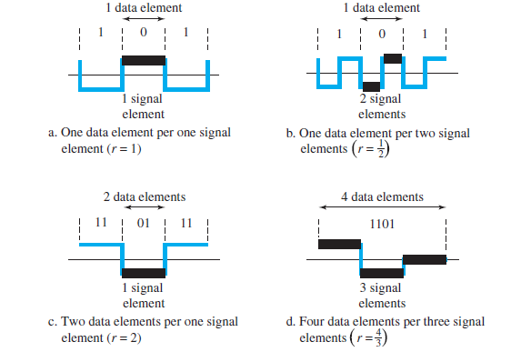

Slide 11
Data Rate Versus Signal Rate
The data rate defines the number of data elements (bits) sent in 1s. The unit is bits per second (bps).
The signal rate is the number of signal elements sent in 1s. The unit is the baud.
The data rate is sometimes called the bit rate; the signal rate is sometimes called the pulse rate, the modulation rate, or the baud rate.

Slide 12
Data Rate Versus Signal Rate (Contd….)
One goal in data communications is to increase the data rate while decreasing the signal rate.
Increasing the data rate increases the speed of transmission; decreasing the signal rate decreases the bandwidth requirement.
the relationship between data rate (N) and signal rate (S)
S = N/r
the average signal rate is defined as
Save = c X N X (1/r) baud
C – case factor

Slide 13
Mapping Data symbols onto Signal levels
A data symbol (or element) can consist of a number of data bits:
1 , 0 or
11, 10, 01, ……
A data symbol can be coded into a single signal element or multiple signal elements
1 -> +V, 0 -> -V
1 -> +V and -V, 0 -> -V and +V
The ratio ‘r’ is the number of data elements carried by a signal element.

Slide 14
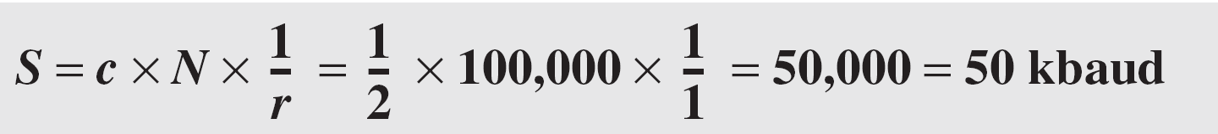
Example
A signal is carrying data in which one data element is encoded as one signal element ( r = 1). If the bit rate is 100 kbps, what is the average value of the baud rate if c is between 0 and 1?
Solution:
We assume that the average value of c is 1/2 . The baud rate is then

Slide 15
Example
The maximum data rate of a channel (see Chapter 3) is Nmax = 2 × B × log₂ L (defined by the Nyquist formula). Does this agree with the previous formula for N_{max}?
Solution:
A signal with L levels actually can carry log₂L bits per level. If each level corresponds to one signal element and we assume the average case (c = 1/2), then we have

Slide 16
Considerations for choosing a good signal element referred to as line encoding
Baseline wandering - a receiver will evaluate the average power of the received signal (called the baseline) and use that to determine the value of the incoming data elements. If the incoming signal does not vary over a long period of time, the baseline will drift and thus cause errors in detection of incoming data elements.
A good line encoding scheme will prevent long runs of fixed amplitude.

Slide 17
Line encoding characteristics
DC components - when the voltage level remains constant for long periods of time, there is an increase in the low frequencies of the signal. Most channels are bandpass and may not support the low frequencies.
This will require the removal of the dc component of a transmitted signal.
Self synchronization - the clocks at the sender and the receiver must have the same bit interval.
If the receiver clock is faster or slower it will misinterpret the incoming bit stream.

Slide 18
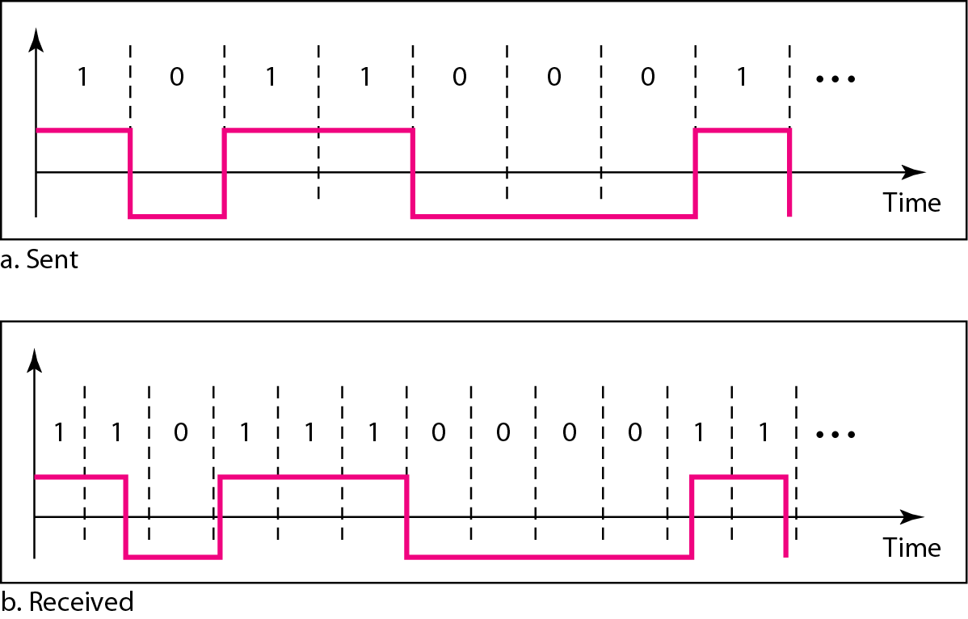
Figure 4.3 Effect of lack of synchronization

Slide 19
Example 4.3
In a digital transmission, the receiver clock is 0.1 percent faster than the sender clock. How many extra bits per second does the receiver receive if the data rate is 1 kbps? How many if the data rate is 1 Mbps?
At 1 kbps, the receiver receives 1001 bps instead of 1000 bps.
At 1 Mbps, the receiver receives 1,001,000 bps instead of 1,000,000 bps.

Slide 20
Line encoding characteristics
Error detection - errors occur during transmission due to line impairments.
Some codes are constructed such that when an error occurs it can be detected.
Noise and interference - there are line encoding techniques that make the transmitted signal “immune” to noise and interference.
This means that the signal cannot be corrupted, it is stronger than error detection.

Slide 21
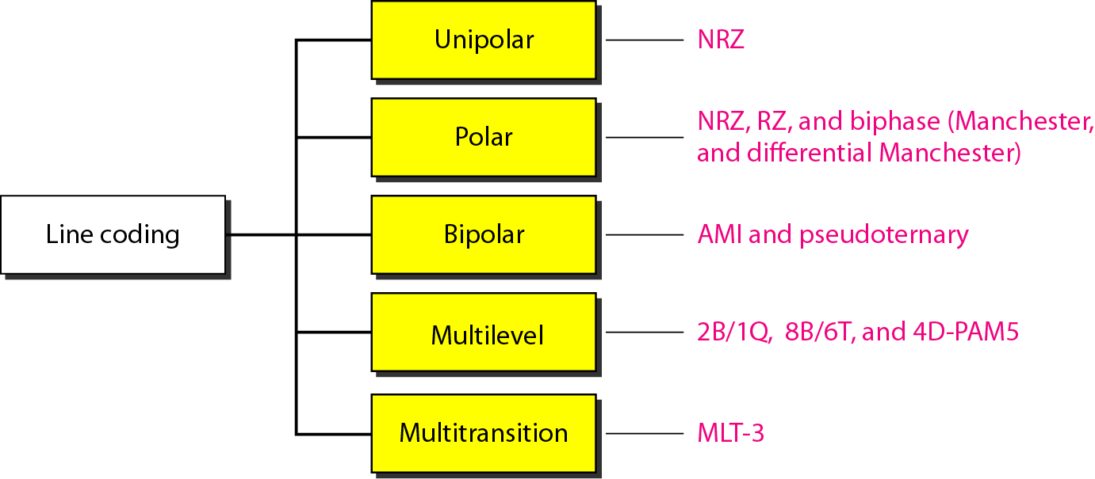
Figure Line coding schemes

Slide 22
Unipolar
All signal levels are on one side of the time axis , either above or below.
+v define 1 and –v define 0.
NRZ - Non Return to Zero scheme is an example of this code. The signal level does not return to zero at a middle of the bit.
Scheme is prone to baseline wandering and DC components. It has no synchronization or any error detection. It is simple but costly in power consumption.

Slide 23
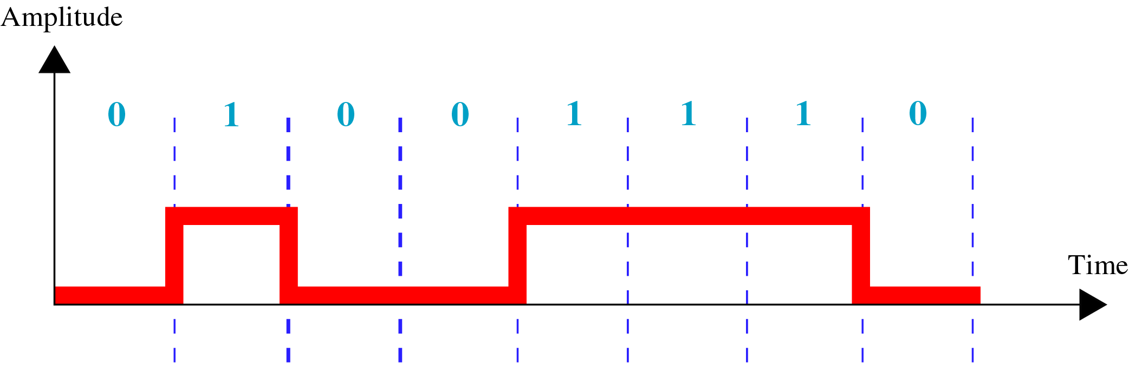
Unipolar Encoding

Slide 24
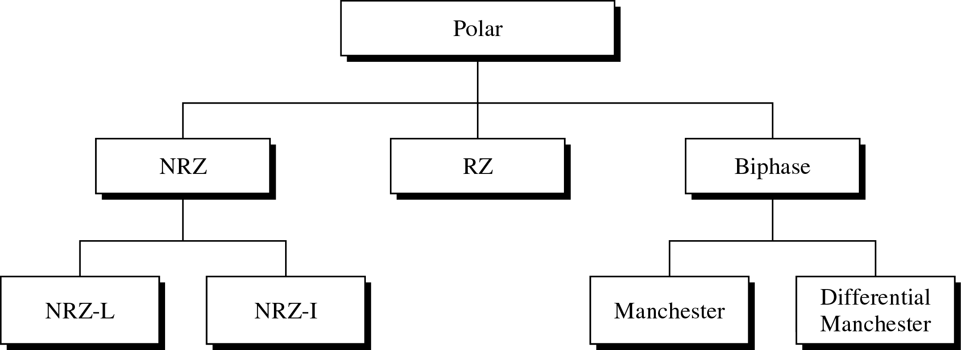
Types of Polar Encoding

Slide 25
Polar - NRZ
The voltages are on both sides of the time axis.
Polar NRZ scheme can be implemented with two voltages. E.g. +V for 0 and -V for 1.
There are two versions:
NZR - Level (NRZ-L) - positive voltage for one symbol and negative for the other
NRZ - Inversion (NRZ-I) - the change or lack of change in polarity determines the value of a symbol. E.g. a “1” symbol inverts the polarity a “0” does not.

Slide 26
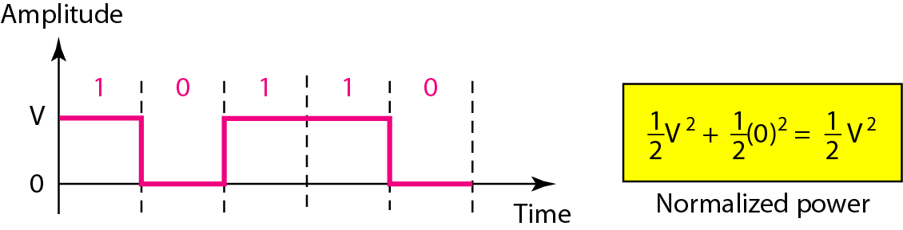
Unipolar NRZ scheme

Slide 27
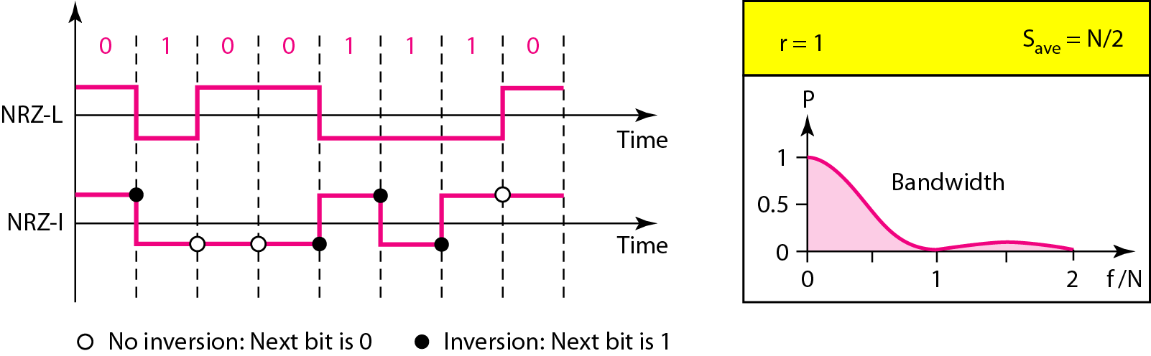
Polar NRZ-L and NRZ-I schemes

Slide 28

Note
In NRZ-L the level of the voltage determines the value of the bit. In NRZ-I the inversion or the lack of inversion determines the value of the bit.
NRZ-L and NRZ-I both have an average signal rate of N/2 Bd.

Slide 29
Note
NRZ-L and NRZ-I both have a DC component problem and baseline wandering, it is worse for NRZ-L. Both have no self synchronization &no error detection. Both are relatively simple to implement.

Slide 30
Example
A system is using NRZ-I to transfer 10-Mbps data. What are the average signal rate and minimum bandwidth?
Solution
The average signal rate is S= N / 2 = 500 kbaud. The minimum bandwidth for this average baud rate is Bmin = S = 500 kHz.
Note c = 1/2 for the avg. case as worst case is 1 and best case is 0

Slide 31
Polar - RZ
The Return to Zero (RZ) scheme uses three voltage values. +, 0, -.
Each symbol has a transition in the middle. Either from high to zero or from low to zero.
This scheme has more signal transitions (two per symbol) and therefore requires a wider bandwidth.
No DC components or baseline wandering.
Not synchronized.
More complex as it uses three voltage level. It has no error detection capability.

Slide 32
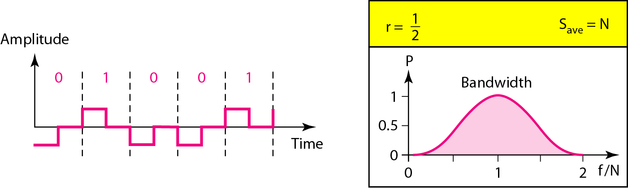
Polar RZ scheme

Slide 33
Polar - Biphase: Manchester and Differential Manchester
Manchester coding consists of combining the NRZ-L and RZ schemes.
Every symbol has a level transition in the middle: from high to low or low to high. Uses only two voltage levels.
Differential Manchester coding consists of combining the NRZ-I and RZ schemes.
Every symbol has a level transition in the middle. But the level at the beginning of the symbol is determined by the symbol value. One symbol causes a level change the other does not.

Slide 34
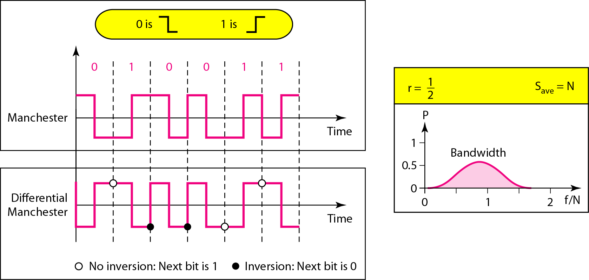
Polar biphase: Manchester and differential Manchester schemes

Slide 35
Note
In Manchester and differential Manchester encoding, the transition
at the middle of the bit is used for synchronization.
The minimum bandwidth of Manchester and differential Manchester is 2 times that of NRZ. The is no DC component and no baseline wandering. None of these codes has error detection.

Slide 36
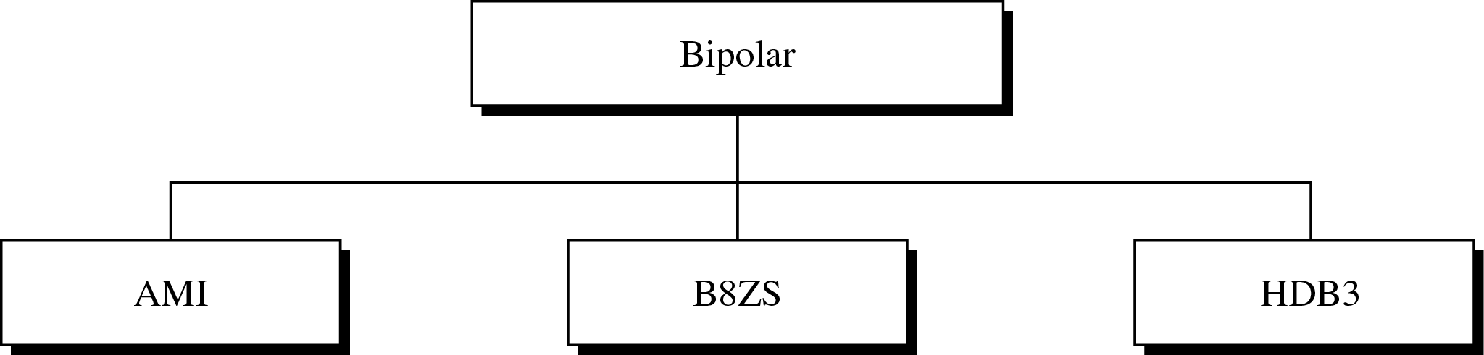
Types of Bipolar Encoding

Slide 37
Bipolar schemes
In this scheme there are three voltage levels positive, negative, and zero. The voltage level for one data element is at zero, while the voltage level for the other element alternates between positive and negative.
The bipolar scheme is an alternative to NRZ.This scheme has the same signal rate as NRZ,but there is no DC component as one bit is represented by voltage zero and other alternates every time.

Slide 38
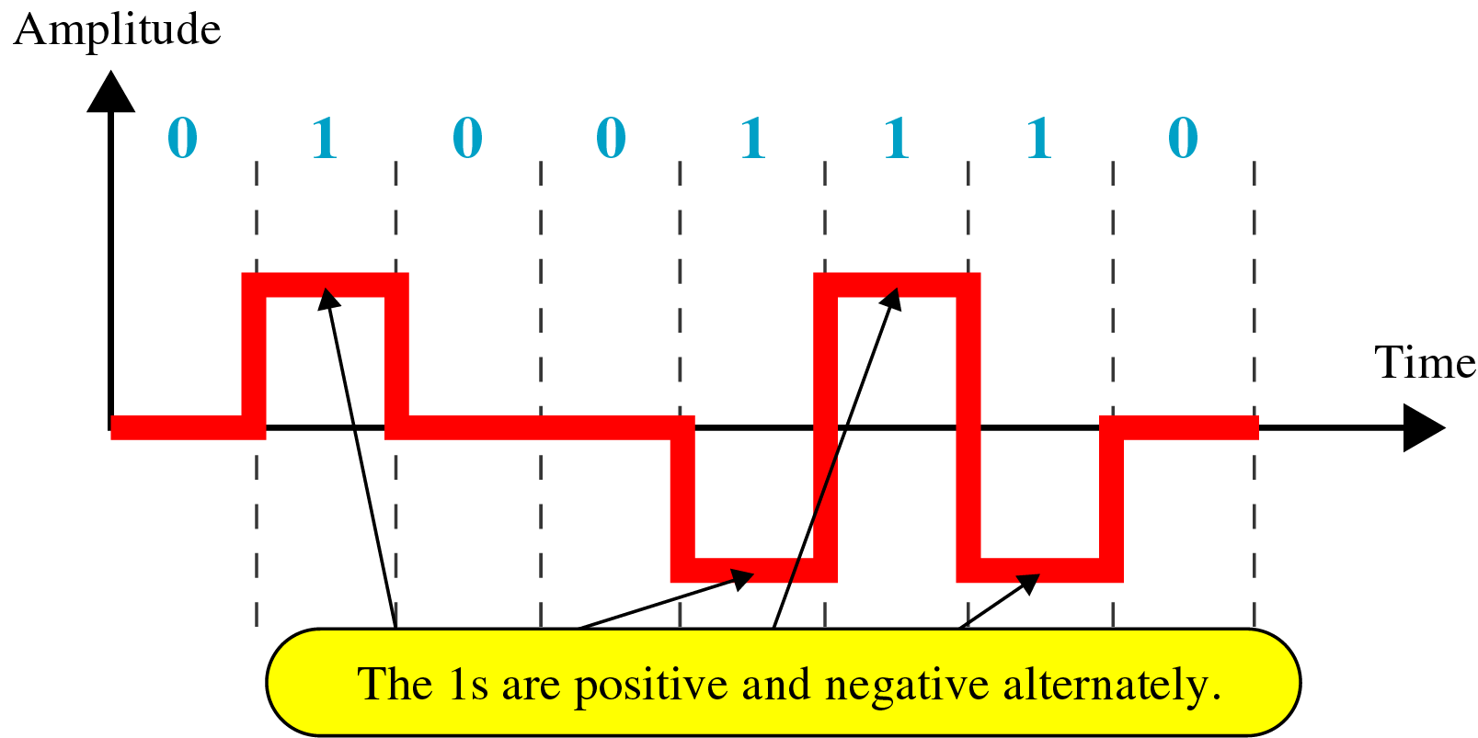
Bipolar AMI Encoding

Slide 39
For example: B8ZS substitutes eight consecutive zeros with 000VB0VB.
The V stands for violation, it violates the line encoding rule
B stands for bipolar, it implements the bipolar line encoding rule

Slide 40
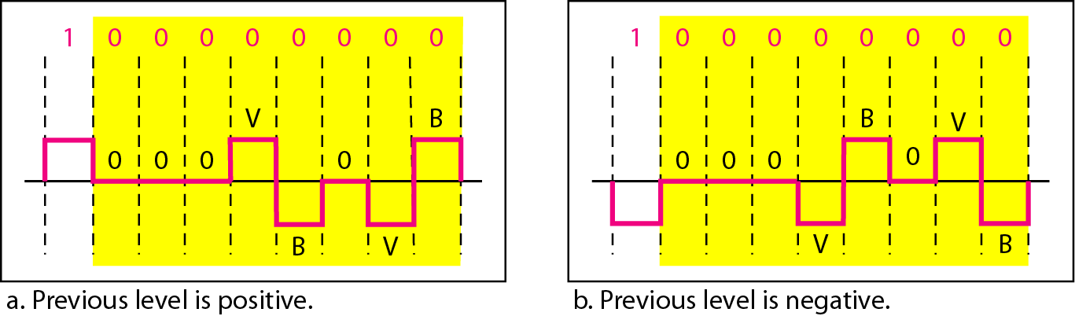
Figure 4.19 Two cases of B8ZS scrambling technique

Slide 41
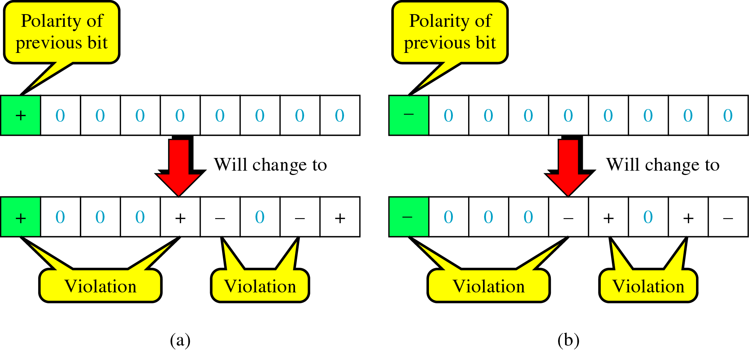
B8ZS Encoding

Slide 42
HDB3 substitutes four consecutive zeros with 000V or B00V depending
on the number of nonzero pulses after the last substitution.
If # of non zero pulses is even the substitution is B00V to make total # of non zero pulse even.
If # of non zero pulses is odd the substitution is 000V to make total # of non zero pulses even.

Slide 43
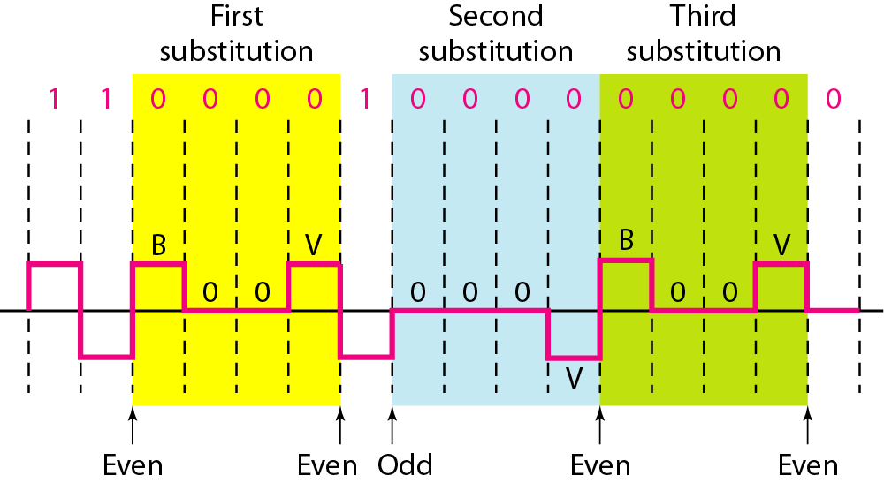
Figure 4.20 Different situations in HDB3 scrambling technique
Even – B00V + → -00-
- → +00+
Odd – 000V + → 000+
- → 000-

Slide 44
ANALOG TO DIGITAL CONVERSION

Slide 45
ANALOG-TO-DIGITAL CONVERSION
A digital signal is superior to an analog signal because it is more robust to noise and can easily be recovered, corrected and amplified. For this reason, the tendency today is to change an analog signal to digital data. In this section we describe two techniques, pulse code modulation and delta modulation.
Topics discussed in this section:
Pulse Code Modulation (PCM)
Delta Modulation (DM)

Slide 46
PCM- Pulse Code Modulation
PCM consists of three steps to digitize an analog signal:
Sampling
Quantization
Binary encoding
Before we sample, we have to filter the signal to limit the maximum frequency of the signal as it affects the sampling rate.
Filtering should ensure that we do not distort the signal, i.e. remove high frequency components that affect the signal shape.

Slide 47
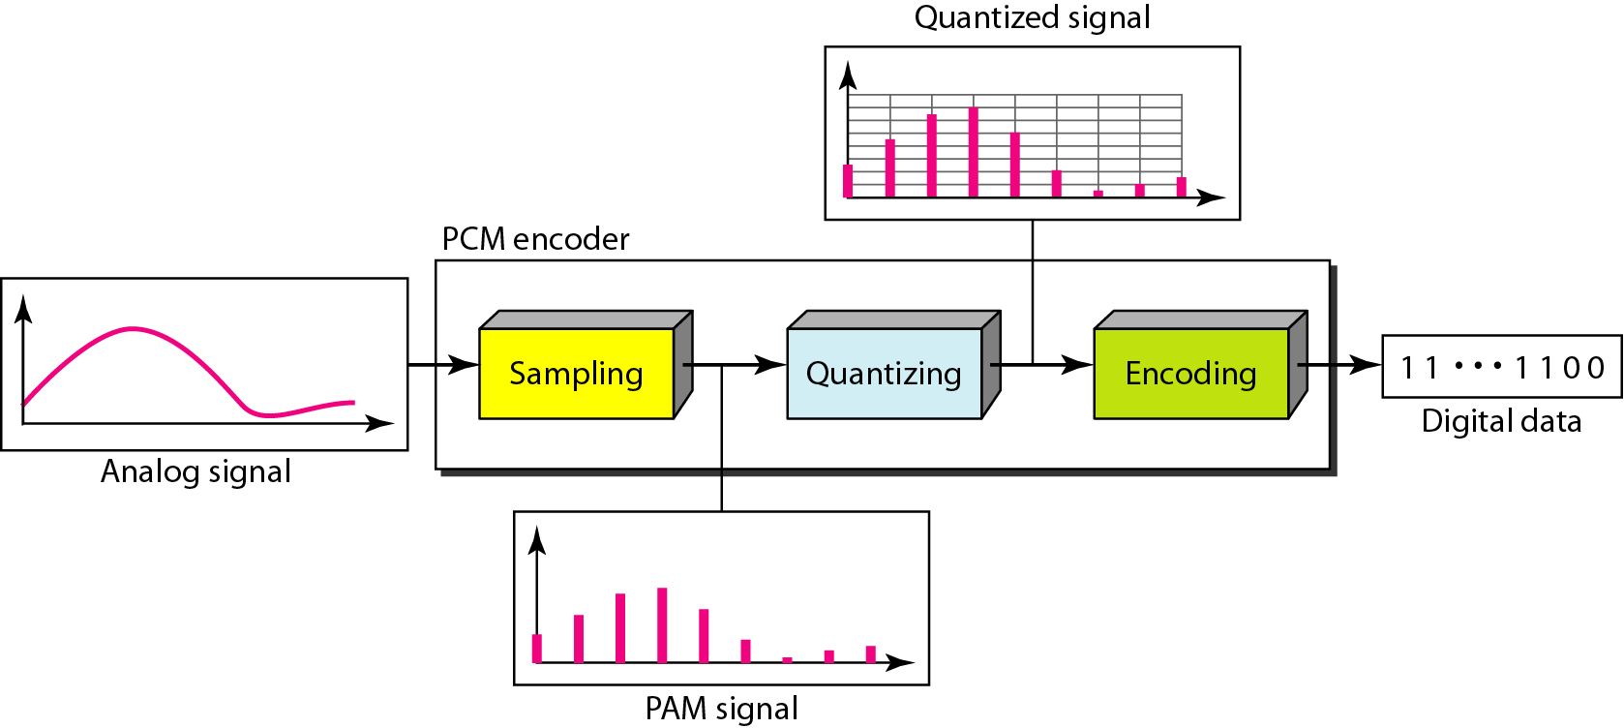
Components of PCM encoder

Slide 48
Sampling
Analog signal is sampled every T_{S} secs.
T_{s} is referred to as the sampling interval.
f_{s} = 1/T_{s} is called the sampling rate or sampling frequency.
There are 3 sampling methods:
Ideal - an impulse at each sampling instant
Natural - a pulse of short width with varying amplitude
Flattop - sample and hold, like natural but with single amplitude value
The process is referred to as pulse amplitude modulation PAM and the outcome is a signal with analog (non integer) values

Slide 49
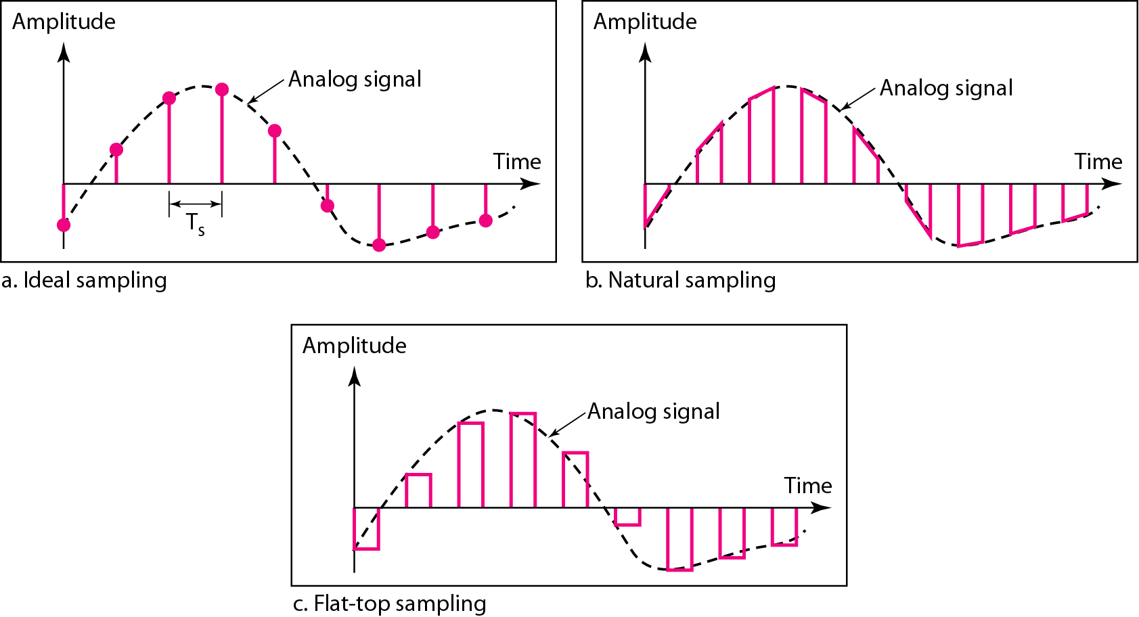
Three different sampling methods for PCM

Slide 50
Note
According to the Nyquist theorem, the sampling rate must be
at least 2 times the highest frequency contained in the signal.

Slide 51
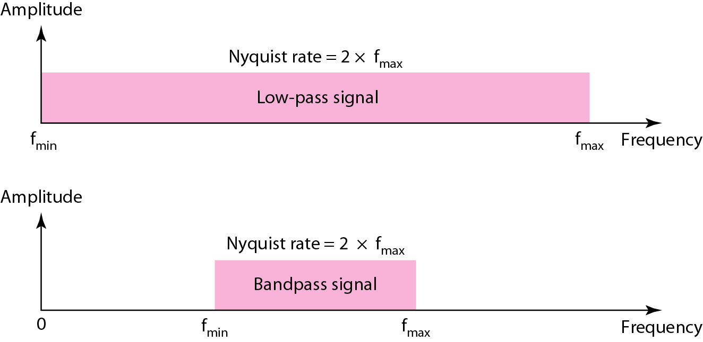
Nyquist sampling rate for low-pass and bandpass signals

Slide 52
Example 1
For an intuitive example of the Nyquist theorem, let us sample a simple sine wave at three sampling rates: f_{s} = 4f (2 times the Nyquist rate), f_{s} = 2f (Nyquist rate), and f_{s} = f (one-half the Nyquist rate). Figure 4.24 shows the sampling and the subsequent recovery of the signal.
It can be seen that sampling at the Nyquist rate can create a good approximation of the original sine wave (part a). Oversampling in part b can also create the same approximation, but it is redundant and unnecessary. Sampling below the Nyquist rate (part c) does not produce a signal that looks like the original sine wave.

Slide 53
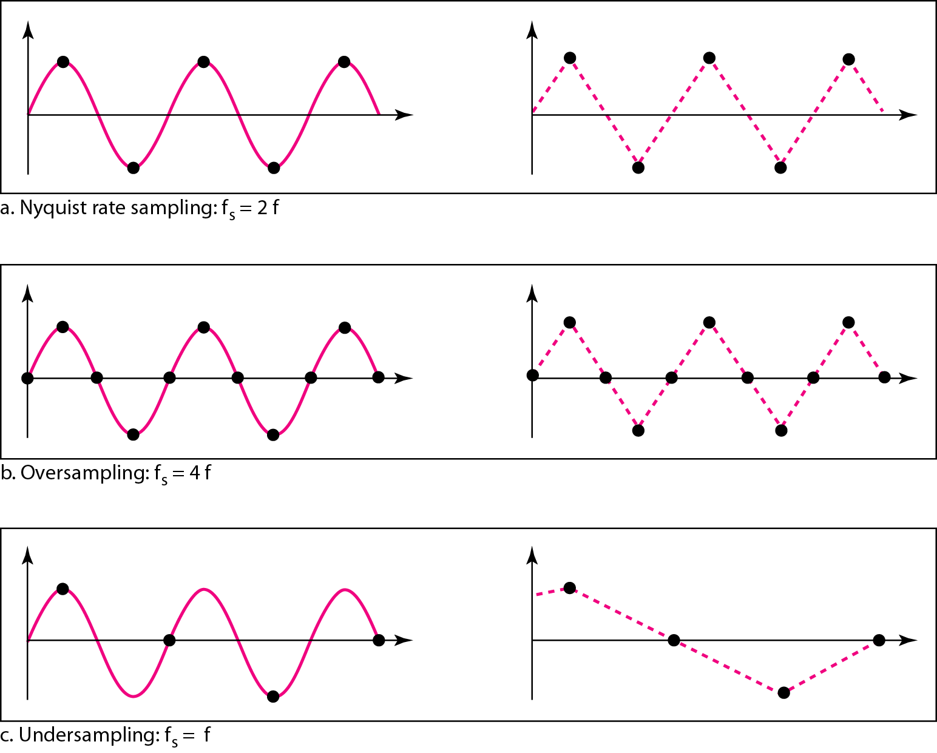
Recovery of a sampled sine wave for different sampling rates

Slide 54
Quantization
Sampling results in a series of pulses of varying amplitude values ranging between two limits: a min and a max.
The amplitude values are infinite between the two limits.
We need to map the infinite amplitude values onto a finite set of known values.
This is achieved by dividing the distance between min and max into L zones, each of height Δ.
Δ = (max - min)/L

Slide 55
Quantization Levels
The midpoint of each zone is assigned a value from 0 to L-1 (resulting in L values)
Each sample falling in a zone is then approximated to the value of the midpoint

Slide 56
Quantization Zones
Assume we have a voltage signal with amplitudes V_{min}=-20V and V_{max}=+20V.
We want to use L=8 quantization levels.
Zone width Δ = (20 - -20)/8 = 5
The 8 zones are: -20 to -15, -15 to -10, -10 to -5, -5 to 0, 0 to +5, +5 to +10, +10 to +15, +15 to +20
The midpoints are: -17.5, -12.5, -7.5, -2.5, 2.5, 7.5, 12.5, 17.5

Slide 57
Assigning Codes to Zones
Each zone is then assigned a binary code.
The number of bits required to encode the zones, or the number of bits per sample as it is commonly referred to, is obtained as follows:
n_{b} = log₂ L
Given our example, n_{b} = 3
The 8 zone (or level) codes are therefore: 000, 001, 010, 011, 100, 101, 110, and 111
Assigning codes to zones:
000 will refer to zone -20 to -15
001 to zone -15 to -10, etc.

Slide 58
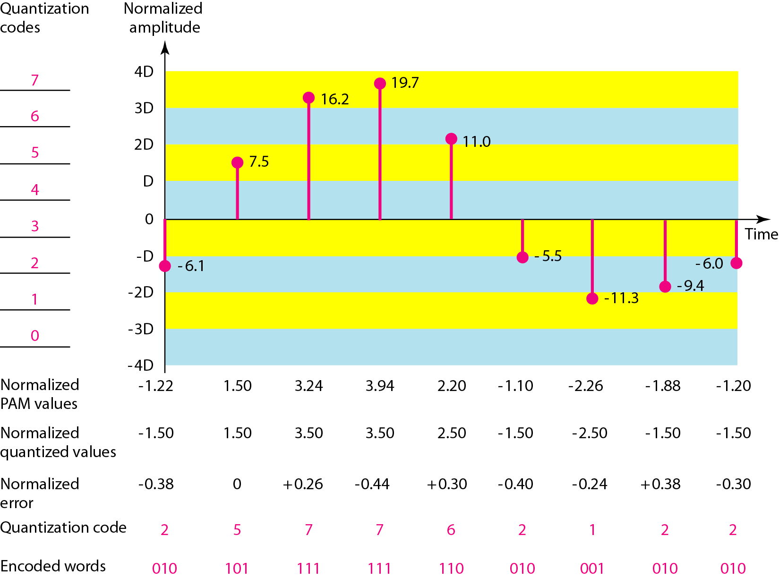
Quantization and encoding of a sampled signal

Slide 59
Quantization Error
When a signal is quantized, we introduce an error - the coded signal is an approximation of the actual amplitude value.
The difference between actual and coded value (midpoint) is referred to as the quantization error.
The more zones, the smaller Δ which results in smaller errors.
BUT, the more zones the more bits required to encode the samples -> higher bit rate

Slide 60
Quantization Error and SN_{Q}R
Signals with lower amplitude values will suffer more from quantization error as the error range: Δ/2, is fixed for all signal levels.
Non linear quantization is used to alleviate this problem. Goal is to keep SN_{Q}R fixed for all sample values.
Two approaches:
The quantization levels follow a logarithmic curve. Smaller Δ’s at lower amplitudes and larger Δ’s at higher amplitudes.
Companding: The sample values are compressed at the sender into logarithmic zones, and then expanded at the receiver. The zones are fixed in height.

Slide 61
Bit rate and bandwidth requirements of PCM
The bit rate of a PCM signal can be calculated form the number of bits per sample x the sampling rate
Bit rate = n_{b} x f_{s}
The bandwidth required to transmit this signal depends on the type of line encoding used. Refer to previous section for discussion and formulas.
A digitized signal will always need more bandwidth than the original analog signal. Price we pay for robustness and other features of digital transmission.

Slide 62
Example
We want to digitize the human voice. What is the bit rate, assuming 8 bits per sample?
Solution
The human voice normally contains frequencies from 0 to 4000 Hz. So the sampling rate and bit rate are calculated as follows:

Slide 63
PCM Decoder
To recover an analog signal from a digitized signal we follow the following steps:
We use a hold circuit that holds the amplitude value of a pulse till the next pulse arrives.
We pass this signal through a low pass filter with a cutoff frequency that is equal to the highest frequency in the pre-sampled signal.
The higher the value of L, the less distorted a signal is recovered.

Slide 64
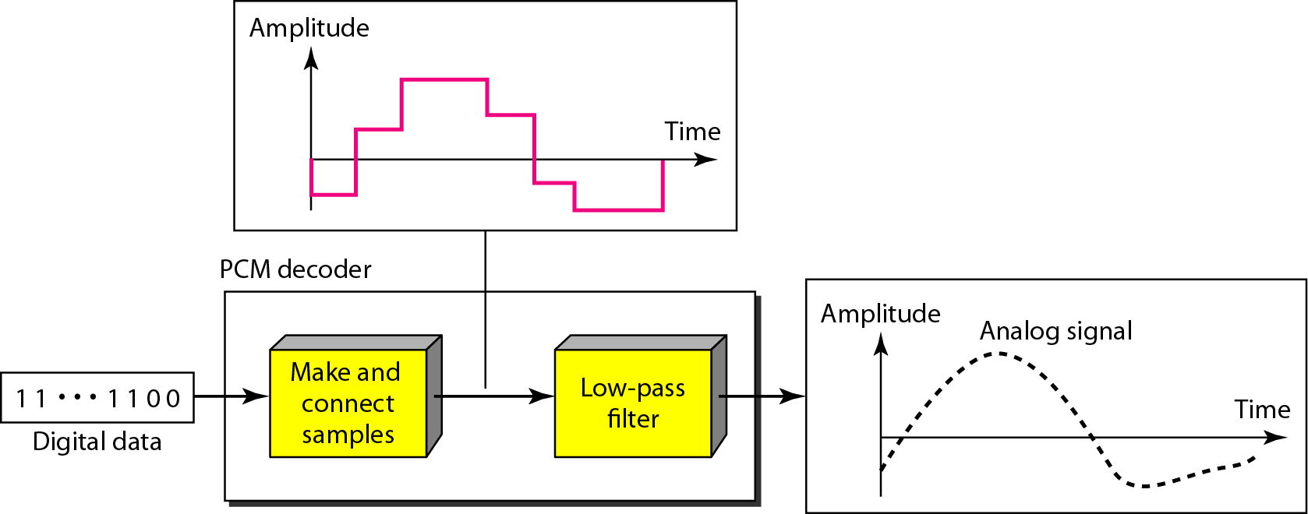
Components of a PCM decoder

Slide 65
Delta Modulation
This scheme sends only the difference between pulses, if the pulse at time t_{n+1} is higher in amplitude value than the pulse at time t_{n}, then a single bit, say a “1”, is used to indicate the positive value.
If the pulse is lower in value, resulting in a negative value, a “0” is used.
This scheme works well for small changes in signal values between samples.
If changes in amplitude are large, this will result in large errors.

Slide 66
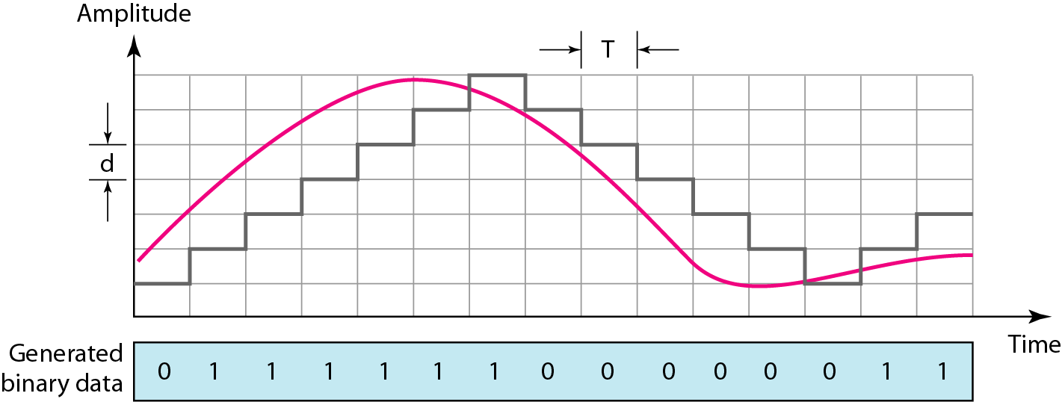
The process of delta modulation

Slide 67
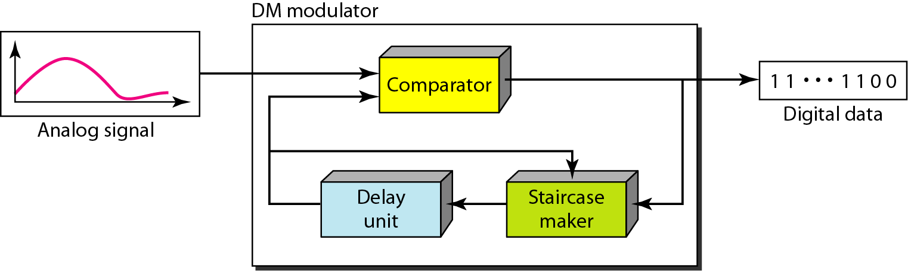
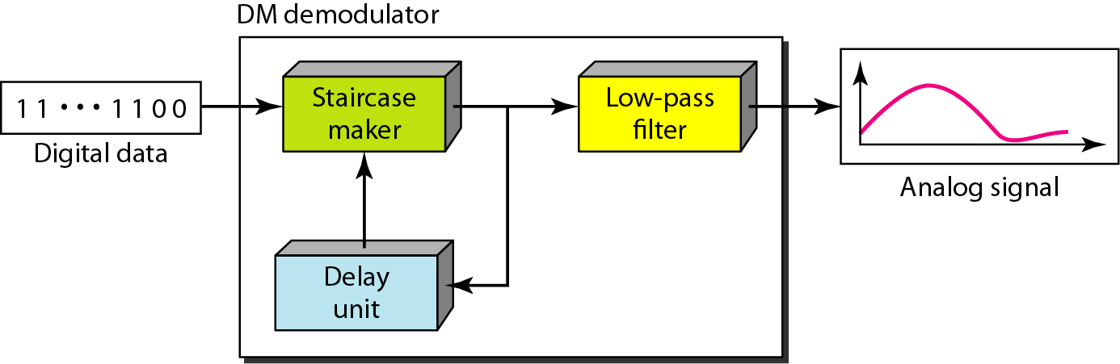
Delta modulation components
Delta demodulation components

Slide 68
Delta PCM (DPCM)
Instead of using one bit to indicate positive and negative differences, we can use more bits -> quantization of the difference.
Each bit code is used to represent the value of the difference.
The more bits the more levels -> the higher the accuracy.

Slide 69
DIGITAL-TO-ANALOG CONVERSION

Slide 70
Digital to Analog Conversion
Converting digital data to a bandpass analog signal is traditionally called digital to- analog conversion
Digital-to-analog conversion is the process of changing one of the characteristics of an analog signal based on the information in digital data.
Digital data needs to be carried on an analog signal.
A carrier signal (frequency f_{c}) performs the function of transporting the digital data in an analog waveform.
The analog carrier signal is manipulated to uniquely identify the digital data being carried.

Slide 71
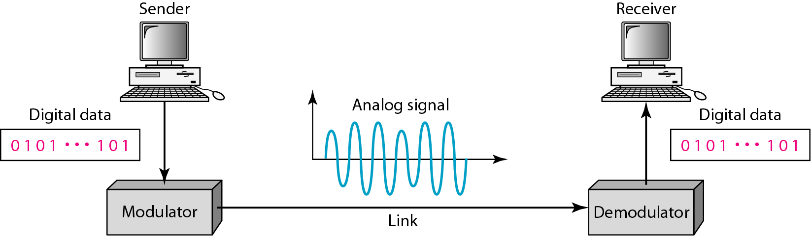
Digital-to-analog conversion
Figure 1 shows the relationship between the digital information, the digital-to-analog modulating process, and the resultant analog signal.

Slide 72
Types of digital-to-analog conversion
Four mechanisms are used for modulating digital data into an analog signal
Amplitude shift keying (ASK)
Frequency shift keying (FSK)
Phase shift keying(PSK)
Quadrature amplitude modulation (QAM – combines ASK &PSK)
QAM is the most efficient and commonly used today

Slide 73
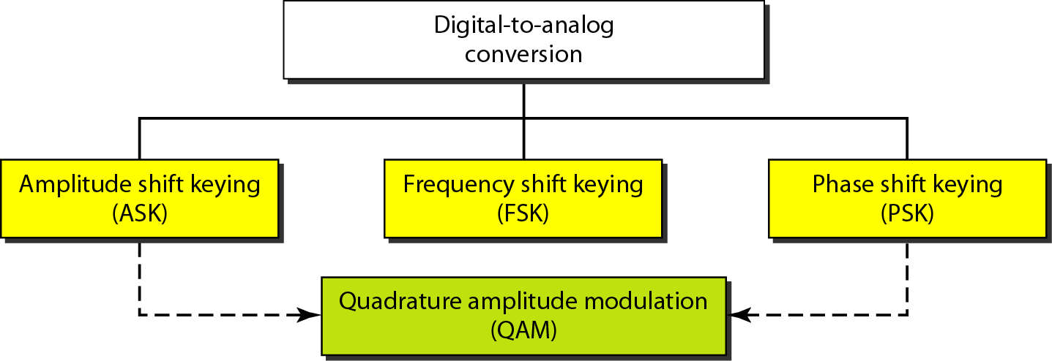
Types of digital-to-analog conversion

Slide 74
Bit and Baud rates and the carrier signal
Bit rate, N, is the number of bits per second (bps). Also called as Data Rate
Baud rate, S is the number of signal elements per second (bauds). Also called as Signal Rate

Slide 75
Cond..
The relationship between them is
S=Nx1/r bauds
Where
S - Signal rate
N - data rate
r - number of data bits per signal element.
In the analog transmission of digital data, the signal or baud rate is less than or equal to the bit rate.

Slide 76
Bit Rate and Baud Rate

Slide 77
Bit Rate and Baud Rate - Continued

Slide 78
Example 1
An analog signal carries 4 bits per signal element. If 1000 signal elements are sent per second, find the bit rate.
Solution
In this case, r = 4, S = 1000, and N is unknown. We can find the value of N from

Slide 79
Example 2
An analog signal has a bit rate of 8000 bps and a baud rate of 1000 baud. How many data elements are carried by each signal element? How many signal elements do we need?
Solution
In this example, S = 1000, N =8000, and rand L are unknown. We find first the value of rand then the value of L.

Slide 80
Amplitude Shift Keying (ASK)
In ASK, the amplitude of the carrier signal is varied to create signal elements. Both frequency and phase remain constant while the amplitude changes.
ASK is implemented by changing the amplitude of a carrier signal to reflect amplitude levels in the digital signal.
For example: a digital “1” could not affect the signal, whereas a digital “0” would, by making it zero.
The line encoding will determine the values of the analog waveform to reflect the digital data being carried.

Slide 81
ASK

Slide 82
Bandwidth of ASK
The bandwidth B of ASK is proportional to the signal rate S.
B = (1+d)S
“d” is depends on modulation and filtering process
“d” value lies between 0 and 1.

Slide 83
Binary ASK (BASK)
ASK is normally implemented using only two levels.
This is referred to as binary amplitude shift keying or on-off keying (OOK).
The peak amplitude of one signal level is 0
the other is the same as the amplitude of the carrier frequency

Slide 84
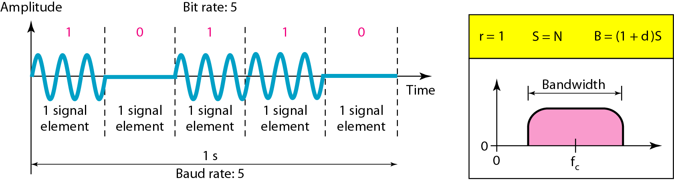
Binary amplitude shift keying

Slide 85
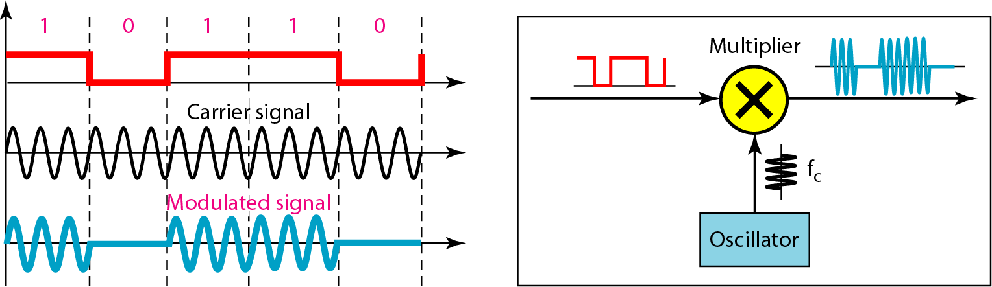
Implementation of binary ASK

Slide 86
If digital data are presented as a unipolar NRZ digital signal with a high voltage of I V and a low voltage of 0 V
Implementation can achieved by multiplying the NRZ digital signal by the carrier signal coming from an oscillator.
When the amplitude of the NRZ signal is 1, the amplitude of the carrier frequency is held;
when the amplitude of the NRZ signal is 0, the amplitude of the carrier frequency is zero.

Slide 87
Example 3
We have an available bandwidth of 100 kHz which spans from 200 to 300 kHz. What are the carrier frequency and the bit rate if we modulated our data by using ASK with d =I?
Solution:
The middle of the bandwidth is located at 250 kHz. This means that our carrier frequency can be at fe =250 kHz. We can use the formula for bandwidth to find the bit rate (with d =1 and r =1).

Slide 88
Example 4
In data communications, we normally use full-duplex links with communication in both directions. We need to divide the bandwidth into two with two carrier frequencies, as shown in Figure 5. The figure shows the positions of two carrier frequencies and the bandwidths. The available bandwidth for each direction is now 50 kHz, which leaves us with a data rate of 25 kbps in each direction.

Slide 89
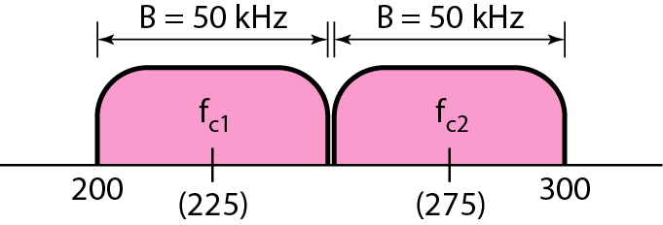
Figure 5 Bandwidth of full-duplex ASK used in Example 4

Slide 90
Frequency Shift Keying
In frequency shift keying, the frequency of the carrier signal is varied to represent data.
The frequency of the modulated signal is constant for the duration of one signal element, but changes for the next signal element if the data element changes.
Both peak amplitude and phase remain constant for all signal elements.
The digital data stream changes the frequency of the carrier signal, f_{c}.
For example,
a “1” could be represented by f₁=f_{c} +Δf,
a “0” could be represented by f₂=f_{c}-Δf.

Slide 91
FSK

Slide 92
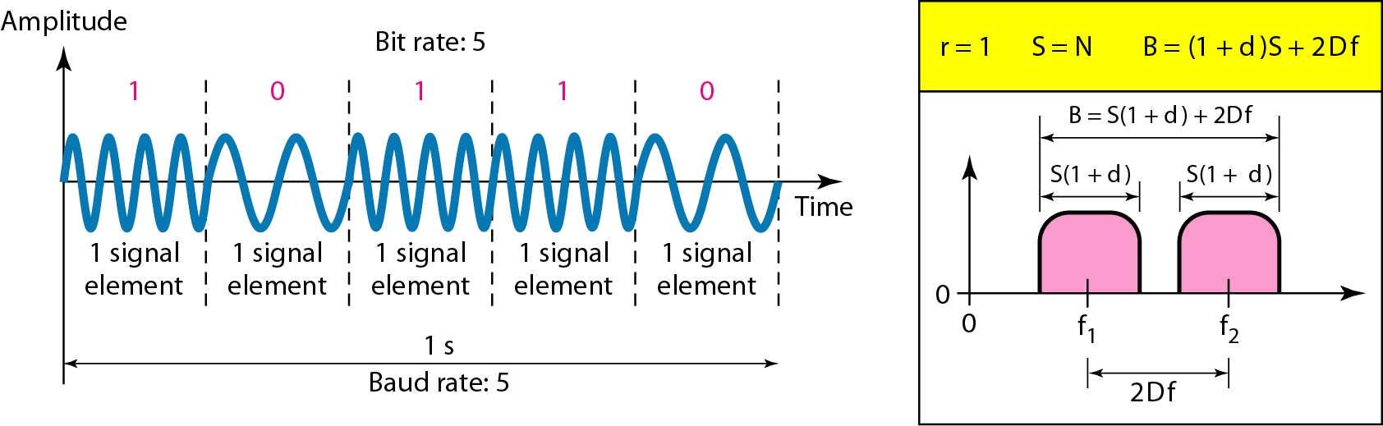
Figure 6 Binary frequency shift keying (BFSK)

Slide 93
Bandwidth of FSK
If the difference between the two frequencies (f₁ and f₂) is 2Δf, then the required BW B will be:
B = (1+d)xS +2Δf

Slide 94
Example 5
We have an available bandwidth of 100 kHz which spans from 200 to 300 kHz. What should be the carrier frequency and the bit rate if we modulated our data by using FSK with d = 1?
Solution
This problem is similar to Example 5.3, but we are modulating by using FSK. The midpoint of the band is at 250 kHz. We choose 2Δf to be 50 kHz; this means

Slide 95
Coherent and Non Coherent
Two implementations of BFSK:
Non-coherent
Coherent.
In a non-coherent FSK scheme, when we change from one frequency to the other, we do not adhere to the current phase of the signal.
In coherent FSK, the switch from one frequency signal to the other only occurs at the same phase in the signal.

Slide 96
Non-coherent BFSK can be implemented by treating BFSK as two ASK modulations and using two carrier frequencies.
Coherent BFSK can be implemented by using one voltage-controlled oscillator (VeO) that changes its frequency according to the input voltage.
Figure 7 shows the implementation.
The input to the oscillator is the unipolar NRZ signal. When the amplitude of NRZ is zero, the oscillator keeps its regular frequency; when the amplitude is positive, the frequency is increased.

Slide 97
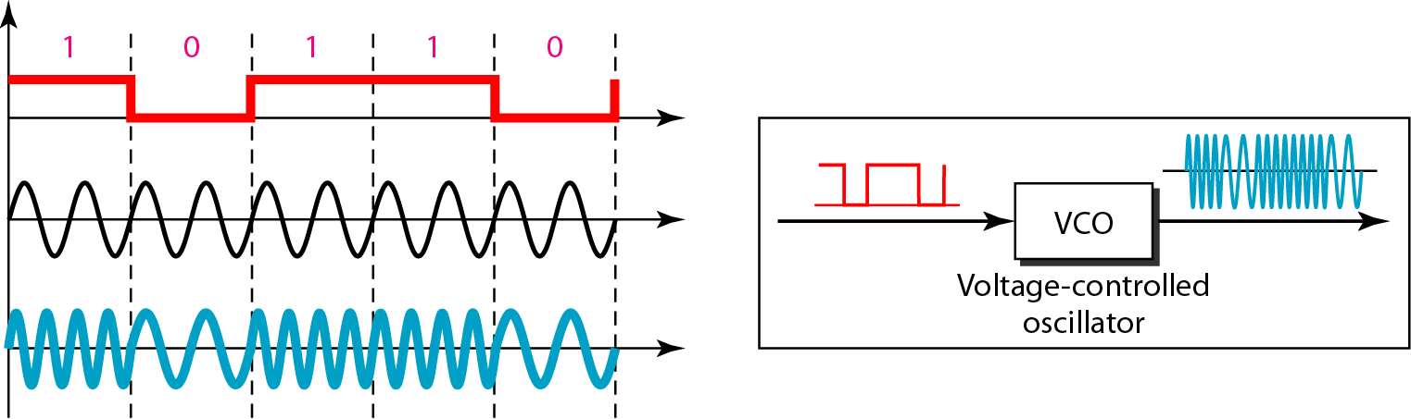
Figure 7 Implementation of BFSK

Slide 98
Multi level FSK
Similarly to ASK, FSK can use multiple bits per signal element.
That means we need to provision for multiple frequencies, each one to represent a group of data bits.
The bandwidth for FSK can be higher
B = (1+d)xS + (L-1)/2Δf = LxS

Slide 99
Example 6
We need to send data 3 bits at a time at a bit rate of 3 Mbps. The carrier frequency is 10 MHz. Calculate the number of levels (different frequencies), the baud rate, and the bandwidth.
Solution
We can have L = 2³ = 8. The baud rate is S = 3 Mbps/3 = 1 Mbaud. This means that the carrier frequencies must be 1 MHz apart (2Δf = 1 MHz). The bandwidth is B = 8 × 1M = 8M. Figure 8 shows the allocation of frequencies and bandwidth.

Slide 100
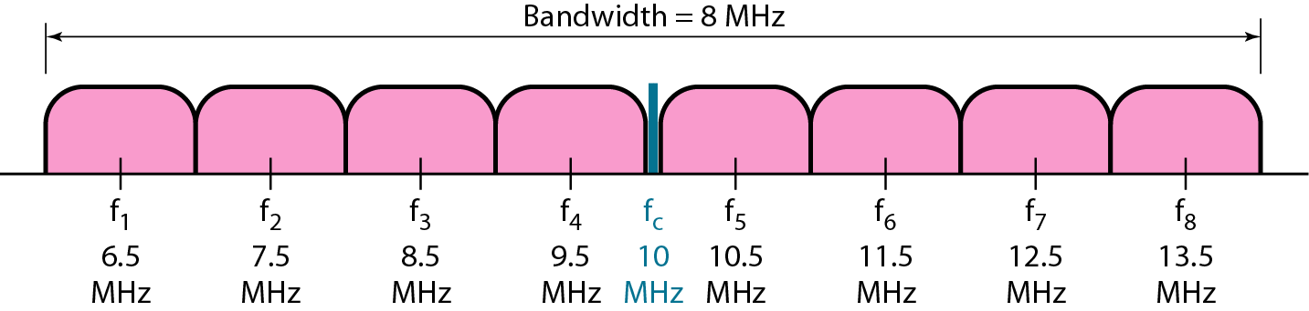
Figure 8 Bandwidth of MFSK used in Example 6

Slide 101
Phase Shift Keying
In PSK, the phase of the carrier is varied to represent two or more different signal elements. Both peak amplitude and frequency remain constant as the phase changes.
Today, PSK is more common than ASK or FSK
We vary the phase shift of the carrier signal to represent digital data.
The bandwidth requirement, B is:
B = (1+d)xS
PSK is much more robust than ASK as it is not that vulnerable to noise, which changes amplitude of the signal.

Slide 102
PSK

Slide 103
Binary phase shift keying (BPSK)
The simplest PSK is binary PSK, in which we have only two signal elements, one with a phase of 0°, and the other with a phase of 180°.
Binary PSK is as simple as binary ASK
PSK is less susceptible to noise than ASK.
PSK is superior to FSK because we do not need two carrier signals.

Slide 104
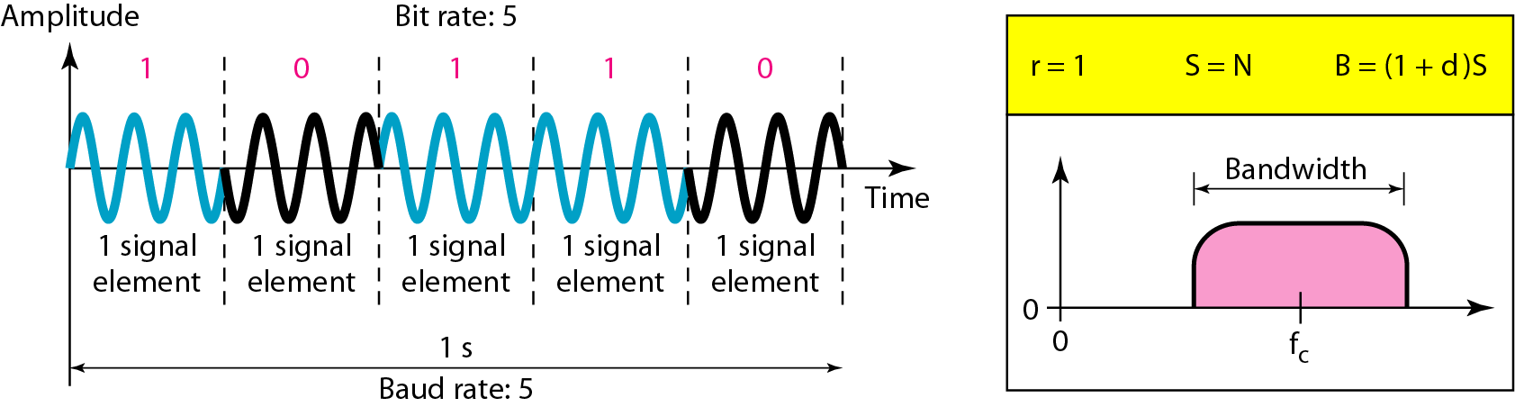
Figure 9 Binary phase shift keying

Slide 105
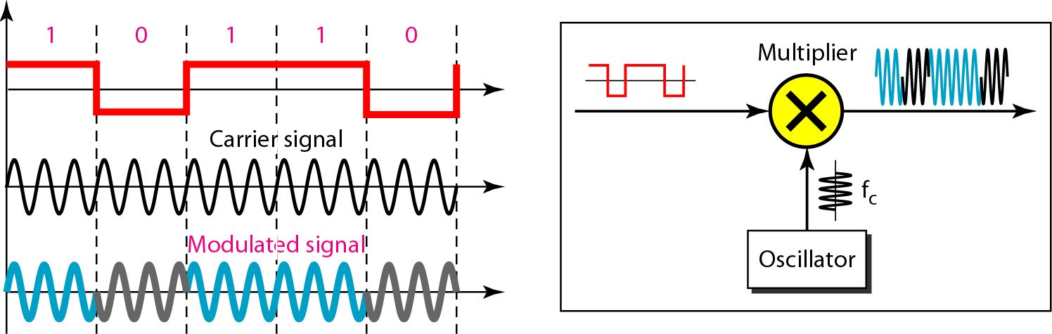
Figure 10 Implementation of BASK

Slide 106
The implementation of BPSK is as simple as that for ASK
The reason is that the signal element with phase 180° can be seen as the complement of the signal element with phase 0°
The polar NRZ signal is multiplied by the carrier frequency;
the 1 bit (positive voltage) is represented by a phase starting at 0°;
the 0 bit (negative voltage) is represented by a phase starting at 180°.

Slide 107
Quadrature PSK
To increase the bit rate, we can code 2 or more bits onto one signal element.
In QPSK, we parallelize the bit stream so that every two incoming bits are split up and PSK a carrier frequency. One carrier frequency is phase shifted 90º from the other - in quadrature.
The two PSKed signals are then added to produce one of 4 signal elements. L = 4 here.

Slide 108
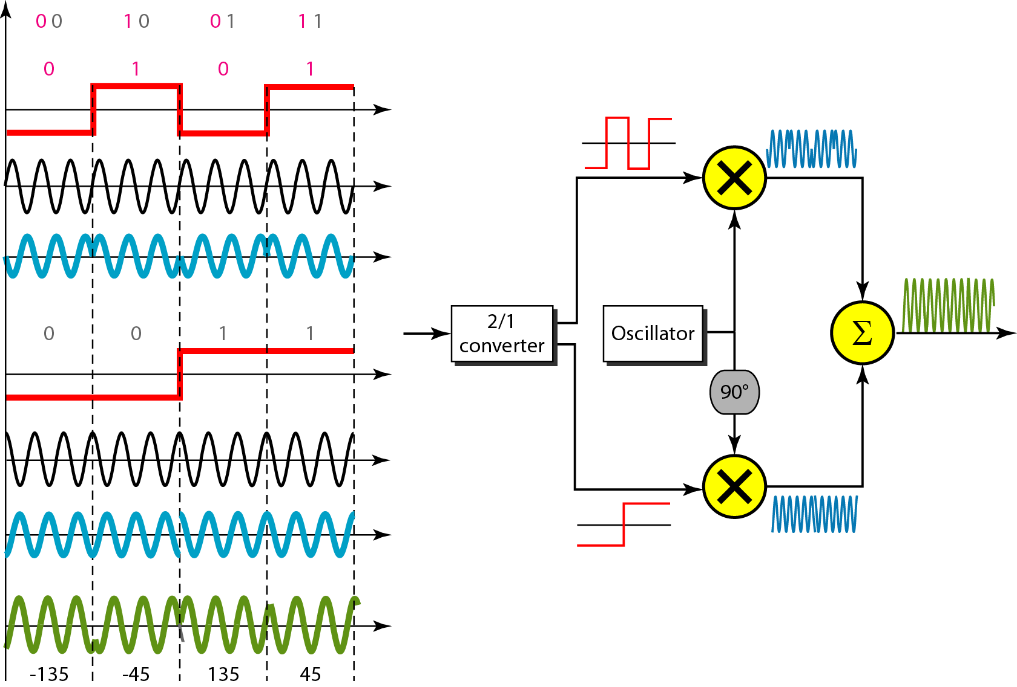
Figure 11 QPSK and its implementation

Slide 109

Example 7
Find the bandwidth for a signal transmitting at 12 Mbps for QPSK. The value of d = 0.
Solution
For QPSK, 2 bits is carried by one signal element. This means that r = 2. So the signal rate (baud rate) is S = N × (1/r) = 6 Mbaud. With a value of d = 0, we have B = S = 6 MHz.

Slide 110
Constellation Diagrams
A constellation diagram helps us to define the amplitude and phase of a signal when we are using two carriers, one in quadrature of the other.
The X-axis represents the in-phase carrier and the Y-axis represents quadrature carrier.

Slide 111
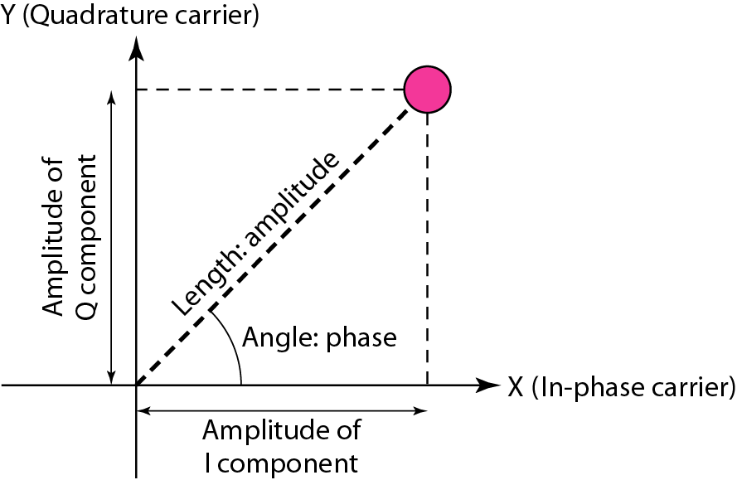
Figure 12 Concept of a constellation diagram

Slide 112
Example 8
Show the constellation diagrams for an ASK (OOK), BPSK, and QPSK signals.
Solution
Figure 5.13 shows the three constellation diagrams.

Slide 113
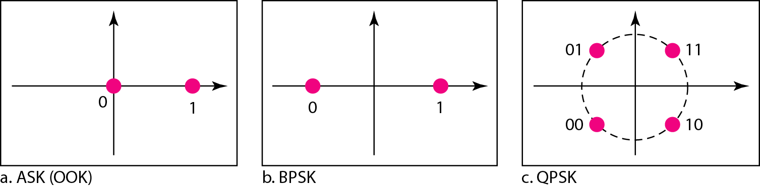
Figure 13 Three constellation diagrams

Slide 114
Quadrature amplitude modulation (QAM) QAM is a combination of ASK and PSK. Bandwidth for QAM The minimum bandwidth required for QAM transmission is the same as that required for ASK and PSK transmission. QAM has the same advantages as PSK over ASK.

Slide 115
4-QAM and 8-QAM
Constellations

Slide 116
16-QAM
Constellation

Slide 117
Multiplexing : Sharing a Medium

Slide 118
Introduction
Introduction-multiplexing and De-multiplexing
What is Multiplexing?
-Multiplexing is a technique used to combine and send the multiple data streams over a single medium. The process of combining the data streams is known as multiplexing and hardware used for multiplexing is known as a multiplexer.
-Multiplexing is achieved by using a device called Multiplexer (MUX) that combines n input lines to generate a single output line. Multiplexing follows many-to-one, i.e., n input lines and one output line.
.

Slide 119
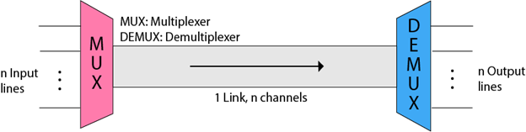
Demultiplexing
Demultiplexing is achieved by using a device called Demultiplexer (DEMUX) available at the receiving end. DEMUX separates a signal into its component signals (one input and n outputs). Therefore, we can say that demultiplexing follows the one-to-many approach.
The 'n' input lines are transmitted through a multiplexer and multiplexer combines the signals to form a composite signal.
The composite signal is passed through a Demultiplexer and demultiplexer separates a signal to component signals and transfers them to their respective destinations

Slide 120
Why Multiplexing?
The transmission medium is used to send the signal from sender to receiver. The medium can only have one signal at a time.
If there are multiple signals to share one medium, then the medium must be divided in such a way that each signal is given some portion of the available bandwidth. For example: If there are 10 signals and bandwidth of medium is100 units, then the 10 unit is shared by each signal.
When multiple signals share the common medium, there is a possibility of collision. Multiplexing concept is used to avoid such collision.
Transmission services are very expensive.
Advantages of Multiplexing:
More than one signal can be sent over a single medium.
The bandwidth of a medium can be utilized effectively.

Slide 121
Multiplexing Techniques
Frequency division multiplexing (FDM)
Time division multiplexing (TDM)
Wavelength division multiplexing (WDM)
Code division multiplexing (CDM)

Slide 122
Frequency Division Multiplexing
Frequency Division Multiplexing (FDM) is a networking technique in which multiple data signals are combined for simultaneous transmission via a shared communication medium.
FDM uses a carrier signal at a discrete frequency for each data stream and then combines many modulated signals.
When FDM is used to allow multiple users to share a single physical communications medium (i.e. not broadcast through the air), the technology is called frequency-division multiple access (FDMA).

Slide 123
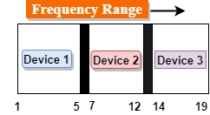
Frequency Division Multiplexing
It is an analog technique.
In the above diagram, a single transmission medium is subdivided into several frequency channels, and each frequency channel is given to different devices. Device 1 has a frequency channel of range from 1 to 5.
The input signals are translated into frequency bands by using modulation techniques, and they are combined by a multiplexer to form a composite signal.
The main aim of the FDM is to subdivide the available bandwidth into different frequency channels and allocate them to different devices.
Using the modulation technique, the input signals are transmitted into frequency bands and then combined to form a composite signal.
The carriers which are used for modulating the signals are known as sub-carriers. They are represented as f1,f2..fn.
FDM is mainly used in radio broadcasts and TV networks.

Slide 124
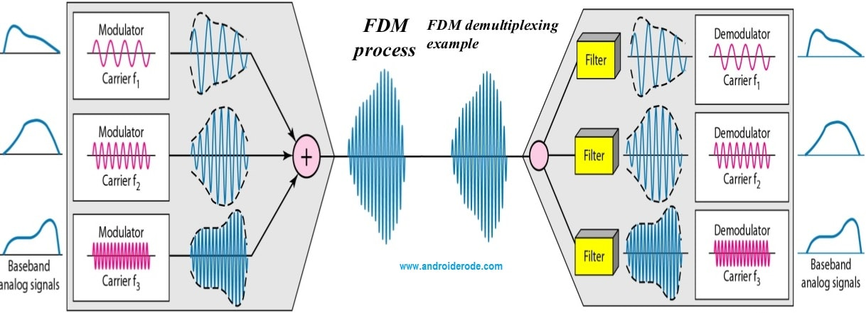

Slide 125
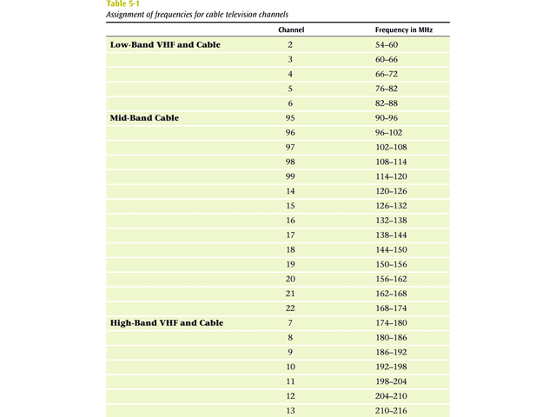
Analog signaling is used to transmits the signals.
Broadcast radio and television, cable television, and the AMPS cellular phone systems use frequency division multiplexing.
This technique is the oldest multiplexing technique.
Since it involves analog signaling, it is more susceptible to noise.

Slide 126
Advantages Of FDM:
FDM is used for analog signals.
FDM process is very simple and easy modulation.
A Large number of signals can be sent through an FDM simultaneously.
It does not require any synchronization between sender and receiver.
Disadvantages Of FDM:
FDM technique is used only when low-speed channels are required.
It suffers the problem of crosstalk.
A Large number of modulators are required.
It requires a high bandwidth channel.
Applications Of FDM:
FDM is commonly used in TV networks.
It is used in FM and AM broadcasting. Each FM radio station has different frequencies, and they are multiplexed to form a composite signal. The multiplexed signal is transmitted in the air.

Slide 127
Time Division Multiplexing
Time-division multiplexing (TDM) is a digital process that allows several connections to share the high bandwidth of a line Instead of sharing a portion of the bandwidth as in FDM, time is shared.
Each connection occupies a portion of time in the link.

Slide 128
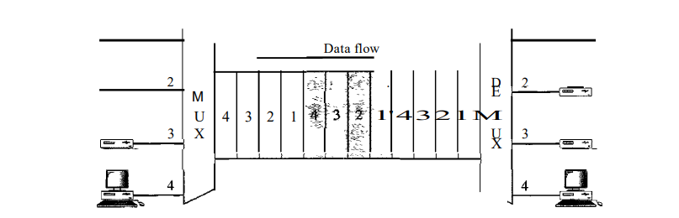
Time Division Multiplexing
Note that the same link is used as in FDM; here, however, the link is shown sectioned by time rather than by frequency. In the figure, portions of signals 1,2,3, and 4 occupy the link sequentially.
Types : synchronous and statistical.

Slide 129
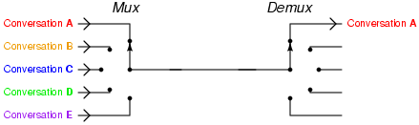

Slide 130
Synchronous Time Division Multiplexing
The original time division multiplexing.
The multiplexor accepts input from attached devices in a round-robin fashion and transmit the data in a never ending pattern.
T-1 and ISDN telephone lines are common examples of synchronous time division multiplexing.

Slide 131
Synchronous TDM
In synchronous TDM, the data flow of each input connection is divided into units, where each input occupies one input time slot.
A unit can be 1 bit, one character, or one block of data. Each input unit becomes one output unit and occupies one output time slot.
However, the duration of an output time slot is n times shorter than the duration of an input time slot. If an input time slot is T s, the output time slot is Tin s, where n is the number of connections.
In other words, a unit in the output connection has a shorter duration; it travels faster.

Slide 132
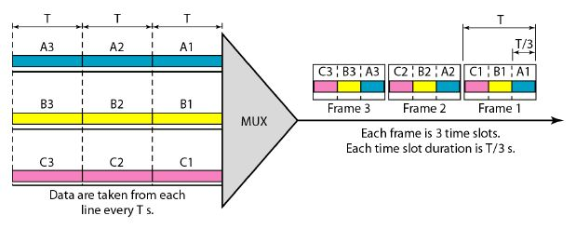
Synchronous TDM
In synchronous TDM, the data rate of the link is n times faster, and the unit duration is n times shorter.

Slide 133
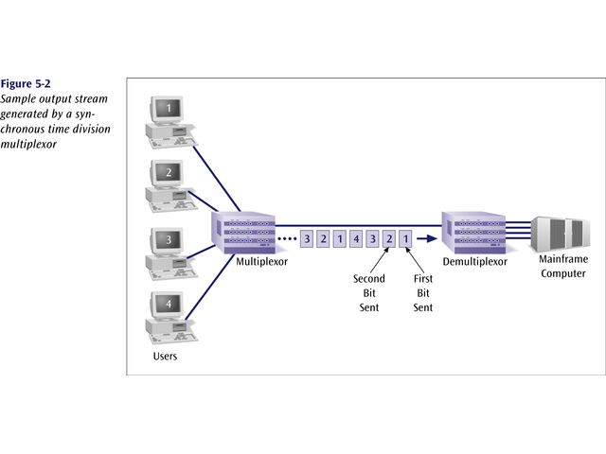
Sample Output Stream generated by a
Synchronous Time Division Multiplexing

Slide 134
Synchronous Time Division Multiplexing
If one device generates data at a faster rate than other devices, then the multiplexor must either sample the incoming data stream from that device more often than it samples the other devices, or buffer the faster incoming stream.
If a device has nothing to transmit, the multiplexor must still insert a piece of data from that device into the multiplexed stream.

Slide 135
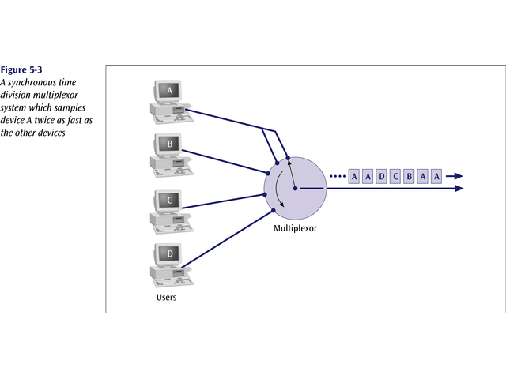
Example

Slide 136
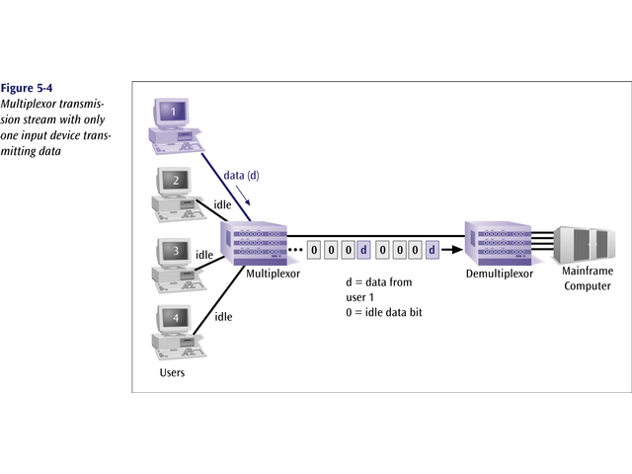

Slide 137

Synchronous time division multiplexing
So that the receiver may stay synchronized with the incoming data stream, the transmitting multiplexor can insert alternating 1s and 0s into the data stream.

Slide 138
Synchronous Time Division Multiplexing
Three types popular today:
T-1 multiplexing (the classic)
ISDN multiplexing
SONET (Synchronous Optical NETwork)

Slide 139
Statistical Time Division Multiplexing
A statistical multiplexor does not require a line over as high a speed line as synchronous time division multiplexing since STDM does not assume all sources will transmit all of the time!
Good for low bandwidth lines (used for LANs)
Much more efficient use of bandwidth!

Slide 140
Statistical Time Division Multiplexing
A statistical multiplexor transmits only the data from active workstations (or why work when you don’t have to).
If a workstation is not active, no space is wasted on the multiplexed stream.
A statistical multiplexor accepts the incoming data streams and creates a frame containing only the data to be transmitted.

Slide 141


Slide 142

To identify each piece of data, an address is included.

Slide 143

If the data is of variable size, a length is also included.

Slide 144

More precisely, the transmitted frame contains a collection of data groups.

Slide 145


Slide 146

Problems
Synchronous TDM with a data stream for each input and one data stream for the output. The unit of data is 1 bit. Find (a) the input bit duration, (b) the output bit duration, (c) the output bit rate, and (d) the output frame rate.

Slide 147
Solution
A. The input bit duration is the inverse of the bit rate: 1/1 Mbps = 1 lls.
b. The output bit duration is one-fourth of the input bit duration, or 1/411s.
c. The output bit rate is the inverse of the output bit duration or 1/4 lls, or 4 Mbps. This can also be deduced from the fact that the output rate is 4 times as fast as any input rate; so the output rate =4 x 1 Mbps =4 Mbps.
d. The frame rate is always the same as any input rate. So the frame rate is 1,000,000 frames per second. Because we are sending 4 bits in each frame, we can verify the result of the previous question by multiplying the frame rate by the number of bits per frame.

Slide 148

Wavelength Division Multiplexing (WDM)
Give each message a different wavelength (frequency).
Easy to do with fiber optics and optical sources

Slide 149
Categories of WDM
Course WDM (CWDM) : CWDM generally operates with 8 channels where the spacing between the channels is 20 nm (nanometers) apart. It consumes less energy than DWDM and is less expensive. However, the capacity of the links, as well as the distance supported, is lesser.
Dense WDM (DWDM) : In DWDM, the number of multiplexed channels much larger than CWDM. It is either 40 at 100GHz spacing or 80 with 50GHz spacing. Due to this, they can transmit the huge quantity of data through a single fiber link. DWDM is generally applied in core networks of telecommunications and cable networks. It is also used in cloud data centers for their IaaS services.

Slide 150
Dense Wavelength Division
Multiplexing (DWDM)
Dense wavelength division multiplexing is often called just wavelength division multiplexing
Dense wavelength division multiplexing multiplexes multiple data streams onto a single fiber optic line.
Different wavelength lasers (called lambdas) transmit the multiple signals.
Each signal carried on the fiber can be transmitted at a different rate from the other signals.
Dense wavelength division multiplexing combines many (30, 40, 50, 60, more?) onto one fiber.

Slide 151

Data Signals Transmitted

Slide 152


Slide 153
Business Multiplexing In Action
XYZ Corporation has two buildings separated by a distance of 300 meters.
A 3-inch diameter tunnel extends underground between the two buildings.
Building A has a mainframe computer and Building B has 66 terminals.
List some efficient techniques to link the two buildings.

Slide 154


Slide 155
Transmission Media

Slide 156

Transmission Media
The physical path between transmitter and receiver is called transmission medium. It is a pathway that carries information from sender to receiver.
In One type of transmission medium , transmission occurs through a solid medium, such as copper twisted pair, copper coaxial cable, and optical fiber
For second type of transmission medium , transmission occurs wireless through the atmosphere, outer space, or water.
It is located below the physical layer and are directly controlled by the physical layer.
Data is transmitted normally in electrical or electromagnetic signals.
Signals are transmitted in the form of electromagnetic energy.

Slide 157
Figure 7.1 Transmission medium and physical layer

Slide 158

Figure 7.2 Classes of transmission media

Slide 159
GUIDED MEDIA
Guided media, which are those that provide a conduit from one device to another, include twisted-pair cable, coaxial cable, and fiber-optic cable.
Topics discussed in this section:
Twisted-Pair Cable Coaxial Cable Fiber-Optic Cable
Twisted-pair and coaxial cable use metallic (copper) conductors that accept and transport signals in the form of electric current.
Optical fiber is a cable that accepts and transports signals in the form of light.

Slide 160
Figure 7.3 Twisted-pair cable

Slide 161
Twisted-pair cable
A twisted pair consists of two conductors (normally copper), each with its own plastic insulation, twisted together.
One of the wires is used to carry signals to the receiver, and the other is used only as a ground reference.
The receiver uses the difference between the two.
In addition to the signal sent by the sender on one of the wires, interference (noise) and crosstalk may affect both wires and create unwanted signals.

Slide 162
Twisted-pair cable
If the two wires are parallel, the effect of these unwanted signals is not the same in both wires because they are at different locations relative to the noise or crosstalk sources
(e,g., one is closer and the other is farther). This results in a difference at the receiver.
By twisting the pairs, a balance is maintained.
For example, suppose in one twist, one wire is closer to the noise source and the other is farther; in the next twist, the reverse is true.

Slide 163
Twisted-pair cable
Twisting makes it probable that both wires are equally affected by external influences (noise or crosstalk).
This means that the receiver, which calculates the difference between the two, receives no unwanted signals. The unwanted signals are mostly canceled out.
From the above discussion, it is clear that the number of twists per unit of length (e.g., inch) has some effect on the quality of the cable.

Slide 164
Effect of Noise on Parallel Lines

Slide 165
Noise on Twisted-Pair Lines

Slide 166
Unshielded Twisted Pair (UTP)
Ordinary telephone wire
Cheapest
Easiest to install
Suffers from external EM interference
Advantages of UTP:
Affordable
Most compatible cabling
Major networking system
Disadvantages of UTP:
Suffers from external Electromagnetic interference
Applications:
Telephone lines connecting subscribers to the central office
DSL lines
LAN – 10Base-T and 100Base-T

Slide 167

Figure 7.4 UTP and STP cables

Slide 168
Unshielded Versus Shielded Twisted-Pair Cable
The most common twisted-pair cable used in communications is referred to as unshielded twisted-pair (UTP).
IBM has also produced a version of twisted-pair cable for its use called shielded twisted-pair (STP).
STP cable has a metal foil or braided mesh covering that encases each pair of insulated conductors.
Although metal casing improves the quality of cable by preventing the penetration of noise or crosstalk, it is bulkier and more expensive.
Our discussion focuses primarily on UTP because STP is seldom used outside of IBM.

Slide 169
Table 7.1 Categories of unshielded twisted-pair cables

Slide 170
Performance
One way to measure the performance of twisted-pair cable is to compare attenuation versus frequency and distance.
A twisted-pair cable can pass a wide range of frequencies.
However, Figure 7.6 shows that with increasing frequency, the attenuation, measured in decibels per kilometer (dB/km), sharply increases with frequencies above 100 kHz.
Note that gauge is a measure of the thickness of the wire.

Slide 171

Figure 7.6 UTP performance

Slide 172

Figure 7.5 UTP connector

Slide 173
Applications
Twisted-pair cables are used in telephone lines to provide voice and data channels.
The local loop-the line that connects subscribers to the central telephone office---commonly consists of unshielded twisted-pair cables.
The DSL lines that are used by the telephone companies to provide high-data-rate connections also use the high-bandwidth capability of unshielded twisted-pair cables.

Slide 174
Coaxial Cable
Coaxial cable (or coax) carries signals of higher frequency ranges than those in twistedpair cable, in part because the two media are constructed quite differently.
Instead of having two wires, coax has a central core conductor of solid or stranded wire (usually copper) enclosed in an insulating sheath, which is, in turn, encased in an outer conductor of metal foil, braid, or a combination of the two.
The outer metallic wrapping serves both as a shield against noise and as the second conductor, which completes the circuit.
This outer conductor is also enclosed in an insulating sheath, and the whole cable is protected by a plastic cover

Slide 175

Figure 7.7 Coaxial cable

Slide 176

Coaxial Cable Standards
Coaxial cables are categorized by their radio government (RG) ratings.
Each RG number denotes a unique set of physical specifications, including the wire gauge of the inner conductor, the thickness and type of the inner insulator, the construction of the shield, and the size and type of the outer casing.
Each cable defined by an RG rating is adapted for a specialized function, as shown in following Table
Table 7.2 Categories of coaxial cables

Slide 177
Coaxial Cable Connectors
To connect coaxial cable to devices, we need coaxial connectors.
The most common type of connector used today is the Bayone-Neill-Concelman (BNC) connector.
The BNC connector is used to connect the end of the cable to a device, such as a TV set.
The BNC T connector is used in Ethernet networks to branch out to a connection to a computer or other device.
The BNC terminator is used at the end of the cable to prevent the reflection of the signal.

Slide 178

Figure 7.8 BNC connectors

Slide 179

Figure 7.9 Coaxial cable performance
As we did with twisted-pair cables, we can measure the performance of a coaxial cable.
We notice in Figure 7.9 that the attenuation is much higher in coaxial cables than in twisted-pair cable.
In other words, although coaxial cable has a much higher bandwidth, the signal weakens rapidly and requires the frequent use of repeaters.

Slide 180
Applications
Coaxial cable was widely used in analog telephone networks where a single coaxial network could carry 10,000 voice signals.
Later it was used in digital telephone networks where a single coaxial cable could carry digital data up to 600 Mbps.
However, coaxial cable in telephone networks has largely been replaced today with fiber-optic cable.
Cable TV networks also use coaxial cables. In the traditional cable TV network, the entire network used coaxial cable.
Later, however, cable TV providers replaced most of the media with fiber-optic cable;
Hybrid networks use coaxial cable only at the network boundaries, near the consumer premises.
Cable TV uses RG-59 coaxial cable.

Slide 181
Applications
Another common application of coaxial cable is in traditional Ethernet LANs Because of its high bandwidth, and consequently high data rate, coaxial
cable was chosen for digital transmission in early Ethernet LANs.
The 10Base-2, or Thin Ethernet, uses RG-58 coaxial cable with BNC connectors to transmit data at 10 Mbps with a range of 185 m.
The lOBase5, or Thick Ethernet, uses RG-11 (thick coaxial cable) to transmit 10 Mbps with a range of 5000 m.
Thick Ethernet has specialized connectors.

Slide 182
Fiber-Optic Cable
A fiber-optic cable is made of glass or plastic and transmits signals in the form of light.
To understand optical fiber, we first need to explore several aspects of the nature of light.
Light travels in a straight line as long as it is moving through a single uniform substance.
If a ray of light traveling through one substance suddenly enters another substance (of a different density), the ray changes direction.
The following figure shows how a ray of light changes direction when going from a more dense to a less dense substance.

Slide 183

Optical fiber

Slide 184

Fiber optics: Bending of light ray

Slide 185
Fiber-Optic Cable
If the angle of incidence I (the angle the ray makes with the line perpendicular to the interface between the two substances) is less than the critical angle, the ray refracts and moves closer to the surface.
If the angle of incidence is equal to the critical angle, the light bends along the interface.
If the angle is greater than the critical angle, the ray reflects (makes a turn) and travels again in the denser substance.
Note that the critical angle is a property of the substance, and its value differs from one substance to another.
Optical fibers use reflection to guide light through a channel.
A glass or plastic core is surrounded by a cladding of less dense glass or plastic. The difference in density of the two materials must be such that a beam of light moving through the core is reflected off the cladding instead of being refracted into it.

Slide 186

Figure 7.12 Propagation modes

Slide 187
Multimode – Step index
Multimode is so named because multiple beams from a light source move through the core in different paths. How these beams move within the cable depends on the structure ofthe core, as shown in Figure 7.13.
In multimode step-index fiber, the density of the core remains constant from the center to the edges. A beam of light moves through this constant density in a straight line until it reaches the interface of the core and the cladding. At the interface, there is an abrupt change due to a lower density; this alters the angle of the beam's motion.
The term step index refers to the suddenness of this change, which contributes to the distortion of the signal as it passes through the fiber

Slide 188
Multimode Step-Index

Slide 189
Multimode – Graded Index
A second type of fiber, called multimode graded-index fiber, decreases this distortion of the signal through the cable. The word index here refers to the index of refraction.
As we saw above, the index of refraction is related to density. A graded-index fiber, therefore, is one with varying densities. Density is highest at the center of the core and decreases gradually to its lowest at the edge.

Slide 190
Multimode Graded-Index

Slide 191
Single-Mode
Single-mode uses step-index fiber and a highly focused source of light that limits beams to a small range of angles, all close to the horizontal.
The singlemode fiber itself is manufactured with a much smaller diameter than that of multimode fiber, and with substantially lower density (index of refraction).
The decrease in density results in a critical angle that is close enough to 90° to make the propagation of beams almost horizontal.
In this case, propagation of different beams is almost identical, and delays are negligible. All the beams arrive at the destination "together" and can be recombined with little distortion to the signal

Slide 192
Single Mode

Slide 193
Table 7.3 Fiber types

Slide 194
Cable Composition
Figure 7.14 shows the composition of a typical fiber-optic cable.
The outer jacket is made of either PVC or Teflon. Inside the jacket are Kevlar strands to strengthen the cable.
Kevlar is a strong material used in the fabrication of bulletproof vests.
Below the Kevlar is another plastic coating to cushion the fiber. The fiber is at the center of the cable, and it consists of cladding and core.

Slide 195

Figure 7.14 Fiber construction

Slide 196
Fiber-optic cable connectors
The subscriber channel (SC) connector is used for cable TV.
It uses a push/pull locking system.
The straight-tip (ST) connector is used for connecting cable to networking devices.
It uses a bayonet locking system and is more reliable than SC.
MT-RJ is a connector that is the same size as RJ45.

Slide 197

Figure 7.15 Fiber-optic cable connectors

Slide 198

Figure 7.16 Optical fiber performance
The plot of attenuation versus wavelength in Figure 7.16 shows a very interesting phenomenon in fiber-optic cable.
Attenuation is flatter than in the case of twisted-pair cable and coaxial cable.
The performance is such that we need fewer (actually 10 times less) repeaters when we use fiber-optic cable.

Slide 199
Applications
Fiber-optic cable is often found in backbone networks because its wide bandwidth is cost-effective.
Some cable TV companies use a combination of optical fiber and coaxial cable, thus creating a hybrid network.
Optical fiber provides the backbone structure while coaxial cable provides the connection to the user premises. This is a cost-effective configuration since the narrow bandwidth requirement at the user end does not justify the use of optical fiber.
Local-area networks such as 100Base-FX network (Fast Ethernet) and 1000Base-X also use fiber-optic cable.

Slide 200
Advantages of Optical Fiber
Higher bandwidth. Fiber-optic cable can support dramatically higher bandwidths (and hence data rates) than either twisted-pair or coaxial cable. Currently, data rates and bandwidth utilization over fiber-optic cable are limited not by the medium but by the signal generation and reception technology available.
Less signal attenuation. Fiber-optic transmission distance is significantly greater than that of other guided media. A signal can run for 50 km without requiring regeneration. We need repeaters every 5 km for coaxial or twisted-pair cable.

Slide 201
Advantages of Optical Fiber
Immunityto electromagnetic interference. Electromagnetic noise cannot affect fiber-optic cables.
Resistance to corrosive materials. Glass is more resistant to corrosive materials than copper.
Light weight. Fiber-optic cables are much lighter than copper cables.
Greater immunity to tapping. Fiber-optic cables are more immune to tapping than copper cables. Copper cables create antenna effects that can easily be tapped.

Slide 202
Disadvantages
Installation and maintenance. Fiber-optic cable is a relatively new technology. Its installation and maintenance require expertise that is not yet available everywhere.
Unidirectional light propagation. Propagation of light is unidirectional. If we need bidirectional communication, two fibers are needed.
Cost. The cable and the interfaces are relatively more expensive than those of other guided media. If the demand for bandwidth is not high, often the use of optical fiber cannot be justified.

Slide 203
7-2 UNGUIDED MEDIA: WIRELESS
Unguided media transport electromagnetic waves without using a physical conductor. This type of communication is often referred to as wireless communication.
Topics discussed in this section:
Radio Waves
Microwaves
Infrared

Slide 204

Figure 7.17 Electromagnetic spectrum for wireless communication

Slide 205

Figure 7.18 Propagation methods
Unguided signals can travel from the source to destination in several ways: ground
propagation, sky propagation, and line-of-sight propagation

Slide 206
In ground propagation, radio waves travel through the lowest portion of the atmosphere, hugging the earth. These low-frequency signals emanate in all directions from the transmitting antenna and follow the curvature of the planet. Distance depends on the amount of power in the signal: The greater the power, the greater the distance.
In sky propagation, higher-frequency radio waves radiate upward into the ionosphere (the layer of atmosphere where particles exist as ions) where they are reflected back to earth. This type of transmission allows for greater distances with lower output power.
In line-or-sight propagation, very high-frequency signals are transmitted in straight lines directly from antenna to antenna. Antennas must be directional, facing each other, and either tall enough or close enough together not to be affected by the curvature of the earth. Line-of-sight propagation is tricky because radio transmissions cannot be completely focused.

Slide 207
The section of the electromagnetic spectrum defined as radio waves and microwaves is divided into eight ranges, called BANDS, each regulated by government authorities.
These bands are rated from very low frequency (VLF) to extremely highfrequency (EHF).

Slide 208
Table 7.4 Bands

Slide 209

Figure 7.19 Wireless transmission waves

Slide 210
Radio Vs Micro Waves
Electromagnetic waves ranging in frequencies between 3 kHz and 1 GHz are normally called radio waves;
Waves ranging in frequencies between 1 and 300 GHz are called microwaves.
However, the behavior of the waves, rather than the frequencies, is a better criterion for classification.
Note
Radio waves are used for multicast communications, such as radio and television, and paging systems. They can penetrate through walls.
Highly regulated. Use omni directional antennas

Slide 211
RADIO WAVES
Radio waves, for the most part, are omnidirectional.
When an antenna transmits radio waves, they are propagated in all directions.
This means that the sending and receiving antennas do not have to be aligned.
A sending antenna sends waves that can be received by any receiving antenna.
Disadvantage:
The radio waves transmitted by one antenna are susceptible to interference by another antenna that may send signals using the same frequency or band.

Slide 212
Radio waves, particularly those waves that propagate in the sky mode, can travel long distances.
Radio waves, particularly those of low and medium frequencies, can penetrate walls.
This characteristic can be both an advantage and a disadvantage.
Advantage: An AM radio can receive signals inside a building.
Disadvantage : We cannot isolate a communication to just inside or outside a building.
The radio wave band is relatively narrow, just under 1 GHz, compared to the microwave band.
When this band is divided into subbands, the subbands are also narrow, leading to a low data rate for digital communications.
Almost the entire band is regulated by authorities (e.g., the FCC in the United States). Using any part of the band requires permission from the authorities.

Slide 213

Applications
The omnidirectional characteristics of radio waves make them useful for multicasting, in which there is one sender but many receivers.
AM and FM radio, television, maritime radio, cordless phones, and paging are examples of multicasting.
Figure 7.20 Omnidirectional antenna

Slide 214
MICROWAVES
Electromagnetic waves having frequencies between 1 and 300 GHz are called microwaves.
Microwaves are unidirectional. When an antenna transmits microwave waves, they can be narrowly focused. This means that the sending and receiving antennas need to be aligned.
The unidirectional property has an obvious advantage. A pair of antennas can be aligned without interfering with another pair of aligned antennas.
CHARACTERISTICS OF MICROWAVE PROPAGATION:
o Microwave propagation is line-of-sight. Since the towers with the mounted antennas need to be in direct sight of each other, towers that are far apart need to be very tall. The curvature of the earth as well as other blocking obstacles do not allow two short towers to communicate by using microwaves. Repeaters are often needed for longdistance communication.
o Very high-frequency microwaves cannot penetrate walls. This characteristic can be a disadvantage if receivers are inside buildings.
o The microwave band is relatively wide, almost 299 GHz. Therefore wider subbands can be assigned, and a high data rate is possible.
o Use of certain portions of the band requires permission from authorities.

Slide 215
Note
Microwaves are used for unicast communication such as cellular telephones, satellite networks, and wireless LANs.
Higher frequency ranges cannot penetrate walls.
Use unidirectional antennas - point to point line of sight communications.

Slide 216
Unidirectional Antenna
Microwaves need unidirectional antennas that send out signals in one direction.
Two types of antennas are used for microwave communications: the parabolic dish and the horn.
A parabolic dish antenna is based on the geometry of a parabola: Every line parallel to the line of symmetry (line of sight) reflects off the curve at angles such that all the lines intersect in a common point called the focus. The parabolic dish works as funnel, catching a wide range of waves and directing them to a common point.
In this way, more of the signal is recovered than would be possible with a single-point receiver.

Slide 217
Horn antenna
A horn antenna looks like a gigantic scoop.
Outgoing transmissions are broadcast up a stem (resembling a handle) and deflected outward in a series of narrow parallel beams by the curved head.
Received transmissions are collected by the scooped shape of the horn, in a manner similar to the parabolic dish, and are deflected down into the stem.

Slide 218

Figure 7.21 Unidirectional antennas

Slide 219
Applications
Microwaves, due to their unidirectional properties, are very useful when unicast (one-to-one) communication is needed between the sender and the receiver.
They are used in cellular phones, satellite networks and wireless LANs.

Slide 220
Wireless Channels
Are subject to a lot more errors than guided media channels.
Interference is one cause for errors, can be circumvented with high SNR.
The higher the SNR the less capacity is available for transmission due to the broadcast nature of the channel.
Channel also subject to fading and no coverage holes.

